Slide 1
JAVA

Slide 2
Enterprise Application
In today's world, social media websites have become an integral part of one's daily life. Sharing details of every moment of one's day, appreciating other's viewpoints or posts, sharing one's opinions, etc are some of the activities that we perform on a daily basis. And to be a part of this, one has to first log in to the particular website. Any leading social website has more than a billion users operating on it every day. The data shown to one user will be exclusive to that user and may not be shown to any other. Due to this, the amount of data that would have to be stored for this purpose would be huge.
Due to the huge amount of data involved, developing an application similar to a social media website would have to follow a few checkpoints,
It should be large-scale
It should have the potential to accept new functionalities after development
It should be secure
It should also be split into multiple isolated layers.
All these can be achieved by developing an Enterprise application.

Slide 3
An Enterprise Application is a software application that helps enterprises in managing their business-related activities. They are large and complex and solve business-related problems to fulfill the needs of the enterprises.
Few of the enterprise application you would have encountered till now are,
Sparsh
Yammer
Microsoft Outlook
Microsoft Skype
Yours truly (Lex)
Let us see the different layers in an enterprise application.
Since the enterprise application has been used for data manipulation of a large amount of data, it has become huge and complex. Maintaining such a complex application is challenging. And to resolve this, the enterprise application will be divided into different tiers.

Slide 4
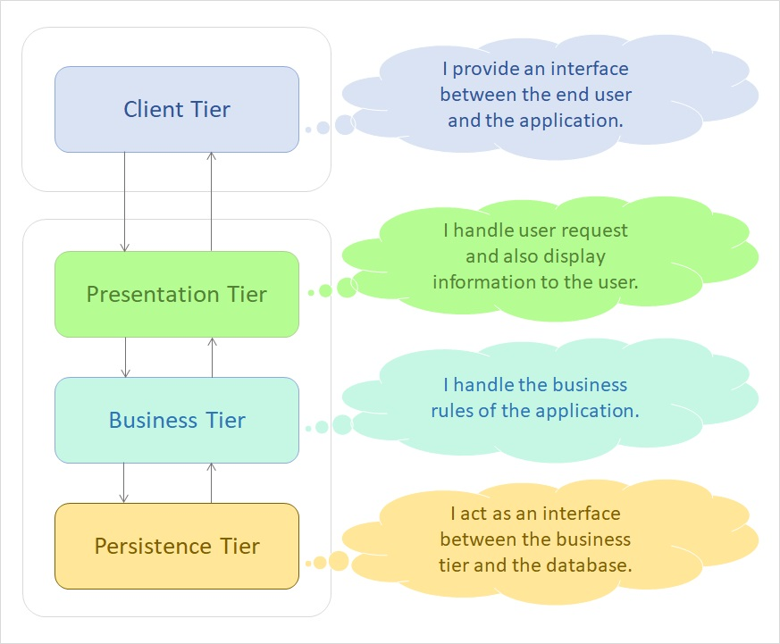

Slide 5
There are 4 tiers that the application is split into,
Client Tier: Acts as an interface to the end-user. Clients can be a web browser or standalone applications which is present in Computer, Mobile etc.
Presentation Tier: This tier links the business logic of the application and the end user. It also takes care of displaying dynamic content to the end-user and accepting various inputs from the user.
Business Tier: This is the most vital part of the application. This tier represents the complete business logic and requirements of the application. All the main functionalities, like data validations and data manipulations lie in this tier of the application.
Persistence Tier: This acts as a go-between for the business tier and the database. It gets the requirements from the business tier, and based on it accesses data from the database.
Let us see which technology we can use to set up an enterprise application.

Slide 6
What is an Enterprise Application?
You have seen the different tiers that an enterprise application is split into. Will Java be used in all the tiers? Or are there any other technologies used? Which technologies can one use in the multiple tiers created?
There are many technologies that can be used in different tiers, but we will be working with a specific set in this training.

Slide 7
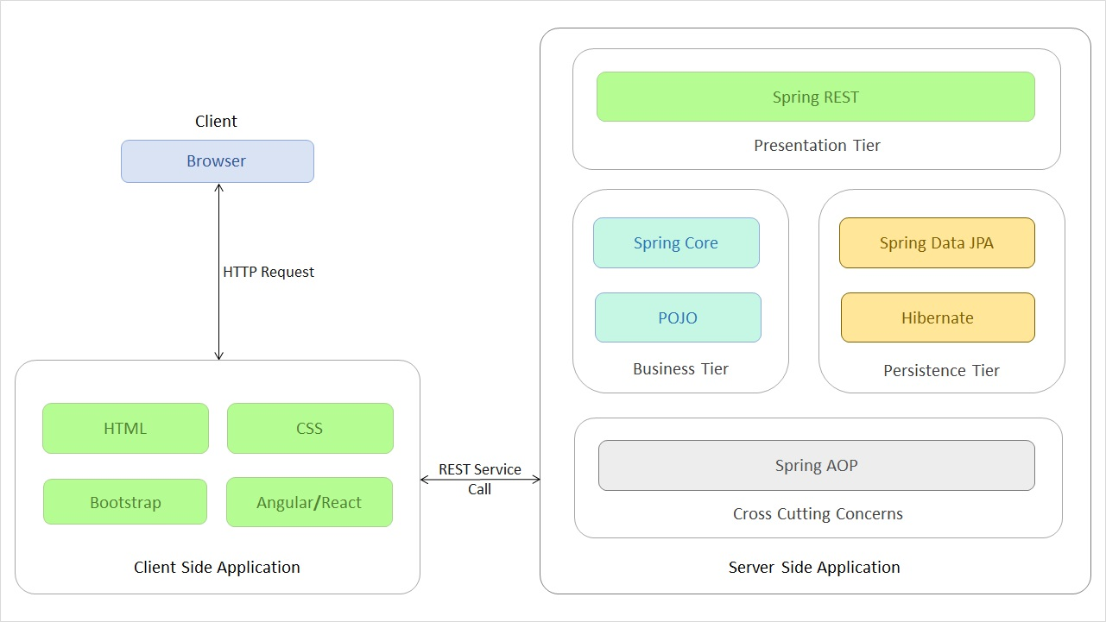
As you can see above, for different tiers, we are using different technologies. In this course, we will focus on the POJO(Plain Old Java Object) part of the Business Tier. POJO is a Java object which has not been bounded to any framework.
The other technologies and tiers will also be discussed in this training.
This course talks about how to create a Java application. Let us see how we split the Java application into the four tiers and how the data flows in the project.

Slide 8
As you saw in the previous page, an enterprise application is divided in four tiers (Client, Presentation, Business
and Persistence) with each having a specific functionality. But how do we split up our project to represent these tiers? Which aspect of our project goes to which tier?
For depicting this distinction, we have four different groups,
User Interface – This is the group that belongs to the Presentation Tier. This group contains the user interface package with a class called Tester. It takes care of processing the inputs from the user and relaying them to the concerned functionalities. For now, we are using a normal Java class. But in future we will use an HTML file to do so.
Service – This is the group that belongs to the Business Tier. This group contains the service package with many Service interfaces and classes. It takes care of authenticating the user inputs, as well as performing all the business logics needed for the application.
Validator – This along with the Service group belongs to the Business Tier. This group contains the validator package with different Validator classes. This class receives user input to be validated for proper format and data.
Data Access Object(DAO) – This is the group that belongs to the Persistence Tier. This group contains the Dao package with many DAO interfaces and classes. It helps the application in interacting with the Database. In this course, we will be mocking the database. In the future courses, we will use the actual database.
Model – This group contains classes which are used to transfer data from one class to the other.

Slide 9
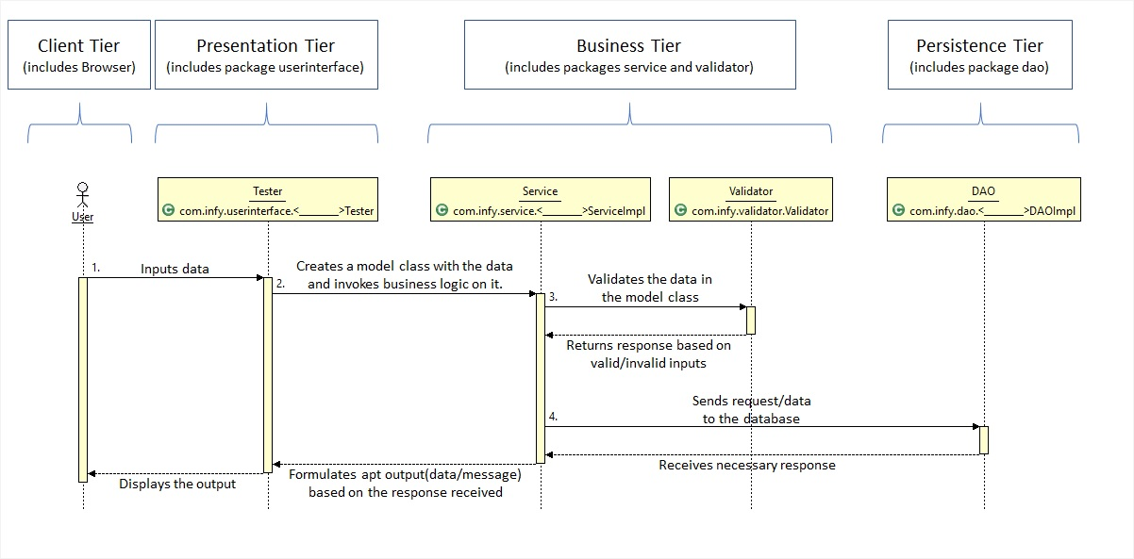

That being said, how does the control flow through each of these tiers? To demonstrate that, please have a look at the below image.

Slide 10
The different steps taking place in the image shown are,
User inputs the data. This data is sent to the Tester class (or the Presentation Tier).
The Tester class converts the raw data to a proper Model class object (Objects used to transfer data from one class to another) and send the object to the Service Class (Business Tier).
The Service class sends the object to the Validator class to get the inputs validated. If the inputs are in valid format, the Validator returns a successful response, else a failure response.
The Service class performs any business operation to be performed on the data before sending it to the DAO class (Persistence Tier).
The Persistence Tier interacts with the database and returns the response of the database.
Based on the responses from the Validator and the DAO classes, the Service class formulates either a successful output or a failure output and return the same to the Tester class.
The Tester class then displays this output to the User.
These steps are the fundamental procedures in any application. Different functionalities can have one or more of the above shown steps in a repeated pattern, but these steps will be there.

Slide 11
Java Architecture
In this course, we will be learning Java, one of the most popular programming language which is used to build an application.
Java has been evolving since 1991 with different editions. In this course, the features of Java till Java 11 has been discussed.
According to the TIOBE Programming Community Index, Java has been one of the top 5 programming languages for several years.
Billions of devices and enterprise desktops are powered by Java technology.
Let us look into the Java Architecture and Features next.

Slide 12
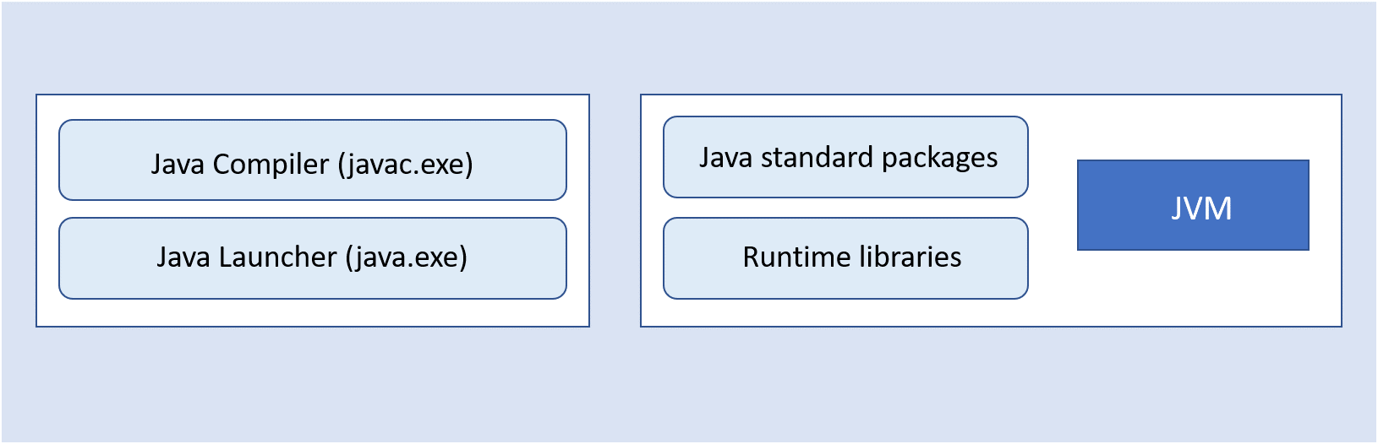
A Java program requires a Java development kit (JDK) for library support and development tools.
Java compiler (javac.exe): A Java compiler is a program that converts source files into the respective byte code. The byte code is platform-independent.
Java launcher (java.exe): Java launcher launches the Java application.
Java standard packages and runtime libraries contain the necessary code for executing Java applications.
Note: Previously, JDK came with a separate implementation for JRE (Java Runtime Environment). Now, starting from Java 11, Adopt OpenJDK does not come with separate JRE implementation; JDK will include JRE implementation. We will be using Adopt OpenJDK in this course.

Slide 13
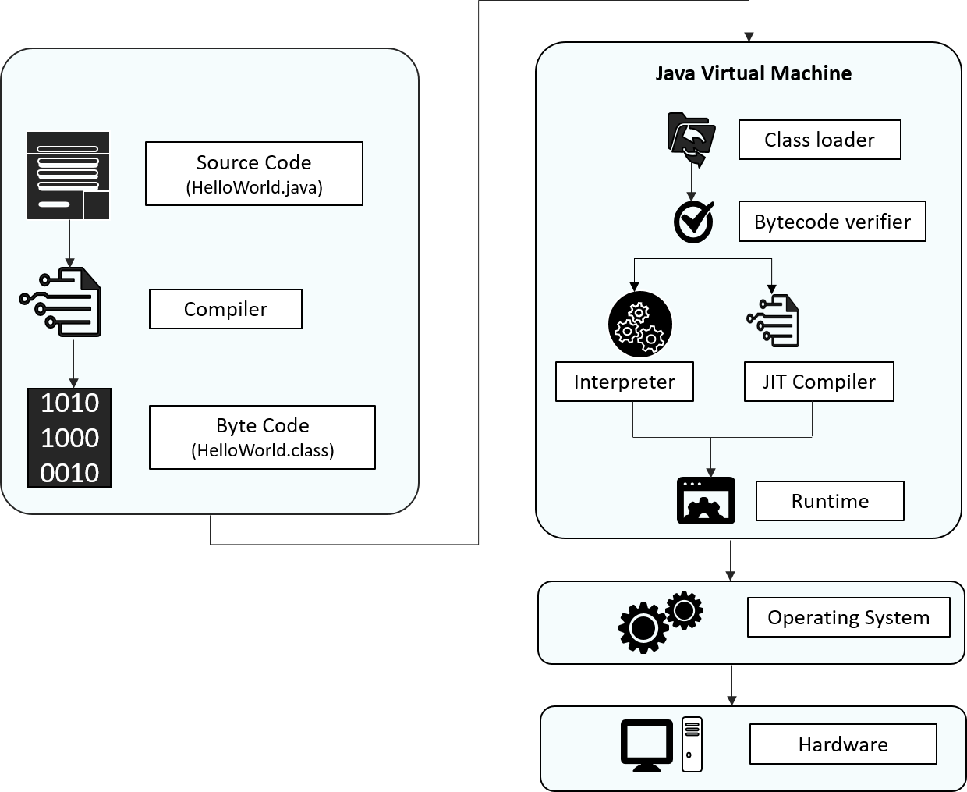
Let us look into the internal work of the Java program, how it is compiled and executed as shown below:

Slide 14
Source code: Program written in Java language
Byte code: A .class file is generated after the Java code is compiled
Class Loader: Loads all the class files needed for execution
Byte code verifier: Checks code for fragments for illegal code
Interpreter: Converts byte code instruction to machine code
Compiler: Compiles reusable byte code instructions to machine code
Runtime: The overall execution of the program is assisted by Runtime.
Note: Graal is a new JIT compiler written entirely in Java. Graal is a high-performance JIT compiler. Graal is independent of Hotspot VM and produces faster native code, which is used to get optimized performance. To know more refer Appendix
Next, let us discuss the different features of Java.

Slide 15
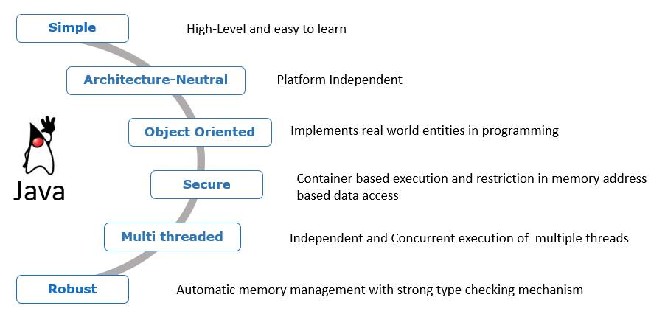
Features of Java
There are many features of java which contribute to its unique, distinguished and super exciting nature:

Slide 16
Simple:
Previously there were many complicated and rarely used features, which have been now removed, thus making Java easy to learn and understand. Apart from that, because of automatic garbage collection in Java, we don't have to deallocate unreferenced objects.
Architecture Neutral:
The compiler first compiles the code written in java and then converts into a "bytecode" (machine-understandable language) file. This feature makes Java platform-independent, as the bytecode file can be run on any platform (Windows, Linux, Mac/OS, Sun Solaris etc.)
Object-Oriented:
Object-Oriented concepts like Object, Class, Inheritance, Polymorphism, Abstraction, and Encapsulation is supported by Java.
Secure:
Java programs run inside a virtual machine sandbox. This enables us to develop more secure systems using Java.

Slide 17
Multi-threaded:
A thread is a separate program that executes concurrently. We can break down a monolithic program handling multiple tasks, into smaller multiple thread-like Java sub-programs that can deal with all the tasks at a given point in time. The main advantage of multi-threading is that threads share a common memory area. Threads are most importantly used for multi-media, web applications, etc.
Robust:
Java is considered robust because
there is strong memory management in Java
Java doesn't use pointers which thus avoid security problems
Java automatically garbage collects unused objects
it supports exception handling and type checking mechanism
Let us understand the concept of platform independence next.

Slide 18
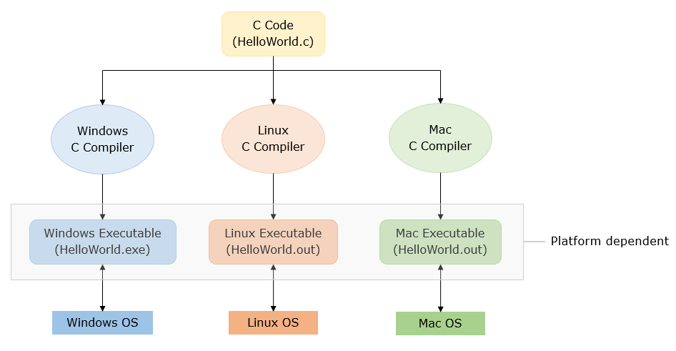
If a program written on a particular platform can run on other platforms without any recompilation, it is known as platform independence.
Since Java is platform-independent, any program written using Java on Windows will execute without any recompilation on any other platform.
To see what platform independence actually is and how it matters, let us compare Java to a platform-dependent language like C.

Slide 19
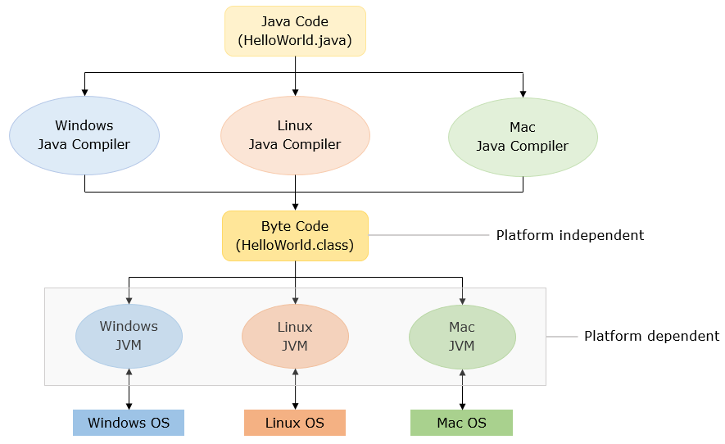
Java is platform-independent whereas JVM is platform dependent. Let us see how Java code executes in different platforms.
Now that we have discussed the features of Java, let us start coding in Java!

Slide 20
Introduction to JShell
Now that we have discussed a few features of Java, let us begin by coding a Java program that prints "Hello World!".
The Java code for printing "Hello World!" is,
public class DemoClass {
public static void main(String[] args) {
System.out.println("Hello World!");
}
}

Slide 21
Note: "main()" is the starting point of execution of all the programs.
The first thing that might come to your mind seeing this code might be, what are all those terms? I just started Java, and have no idea about class, static, public, etc. Those terms that you saw are the basic constructs in the Java language. Without them, Java does not work.
But you wanted to just print a normal "Hello World" and you just started learning Java. Would you have to learn all that to just print "Hello World"? Yes, you have to. To print a normal "Hello World", you do have to write a huge code as shown. But is that the only way to learn Java programming?
No, it isn’t. Due to a new addition in the Java language (from Java 9), learning of basics is simplified. That addition is the JShell.
Let us now see what's JShell.

Slide 22
What is JShell?
JShell is a command-line tool which can execute Java code snippets, and it does not require to write a complete Java program. It is Java REPL (Read-Evaluate-Print-Loop) like other languages such as Scala, Groovy, etc. With JShell, not only will the beginners find it easy to start learning the Java programming language, but the developers will also find it easy to test code snippets and incrementally build prototypes. JShell helps us try out code on different options, to test individual statements, and to explore different APIs. You can write the program elements one by one and see the results immediately.
How JShell works?
If you are wondering how snippets in JShell can be executed without having a class or a method, JShell uses the following steps to execute the code:
Code is parsed and its type is determined (variable declaration, expressions, method, class, etc.) 2. The code is wrapped inside synthetic methods and classes. Import statements are used as is 3. The wrapped source code is analyzed and compiled by the regular Java compiler 4. The generated bytecode is executed in a JVM, and the result is displayed by the JShell tool
Next, we will be using JShell to learn the fundamentals of Java.

Slide 23
How to work in JShell?
Now let us code the Hello World program using JShell. To execute the code in JShell, JShell tool needs to be launched in command prompt as shown below in steps
Step 1: Starting JShell To start JShell, enter the JShell command, JShell, in the terminal of IDE or command prompt. The following example shows the command and the response from JShell:
D:\Java11>jshell
| Welcome to JShell -- Version 11.0.1
| For an introduction type: /help intro
jshell>
JShell can also be launched with --start DEFAULT and --start PRINTING options which provide several library files made available by default.
PRINTING option to make the print methods available as top-level methods, allowing us to use methods like print(), println(), printf() directly on JShell. But unlike DEFAULT this will not add any frequently used libraries (for example Data Structure Libraries like List).

Slide 24
Using --start DEFAULT option
D:\Java11>jshell --start DEFAULT
| Welcome to JShell -- Version 11.0.1
| For an introduction type: /help intro
jshell>
Using --start PRINTING option
D:\Java11>jshell --start PRINTING
| Welcome to JShell -- Version 11.0.1
| For an introduction type: /help intro
jshell> println("Hello World!");
Hello World!
Step 2: After launching JShell write the following code on JShell command prompt and press enter to get the output:

Slide 25
jshell> System.out.println("Hello World!");
Hello World!
jshell>
Congratulations! Your first Java Program is executed using JShell.
Note: Every code written in JShell will have a specific id allotted to it. Using /list command, you can get a list of code snippets executed in JShell. As you can see below, we have executed only the print statement, and it has its id.
jshell> /list
1 : System.out.println("Hello World!");
jshell>
Step 3: Closing Jshell
We can exit from the JShell tool using the /exit command which will return you to the command prompt.

Slide 26
jshell> /exit
| Goodbye
D:\Java11>
Exceptions in JShell
In JShell, there is no need to handle checked exceptions. If a snippet throws a checked exception, the stack trace will be shown and JShell will continue. Though if a snippet throwing a checked exception is used inside a method, it will have to be handled or declared to be thrown.
Note: Checked Exceptions are the exception encountered during compile-time. We will discuss them further in the course.
For further reading on JShell, you can refer to the Oracle Docs by clicking Java Shell User’s Guide.
Let us see the Java Installations next.

Slide 27
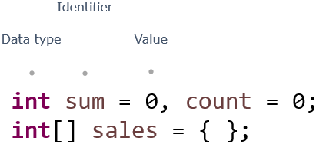
Keywords and Data Types
In programs, data values are stored in memory locations identified by names (identifiers). Such named memory locations are called variables.
Notice how variables are declared using types, identifiers, and assigned values:

Slide 28
As you have seen, a program is composed of several components, blocks, and words.
Some of these words are reserved and have a special meaning in Java, e.g. class, public, void, for, int, static. These words are called keywords. There are 50 keywords in Java 8.
Apart from keywords, there are other words that are used as names to identify components in a program, e.g. sum, index. These words are called Identifiers.
Identifiers are names used for identifying components of a program like classes, methods, interfaces, enums, and variables. Once declared, these names can be used to identify those components later in the program.
Now use JShell to execute the below code. Copy and paste the below code in JShell command prompt
int pizzaPrice = 250, totalCost = 0;
int quantity = 3;
System.out.println("TotalCost:" + pizzaPrice*quantity);

Slide 29
Rules for naming identifiers:
case sensitive
should not start with a number
should start with a letter, $ or _
should not have spaces
should not be a Java keyword or a literal
no restriction on the length
Note: The identifier should not have the only _ in its name.
Example :
Valid Identifiers: CustomerName, grade_in_first_attempt, marksScoredIn3rdAttempt
Invalid Identifiers: model number, 1ofAKind, double
Next, let us see how we can declare a variable.

Slide 30
Now let us see how to declare variables in Java. While declaring variables, we have to specify the kind of data they will hold.
A data type defines the type of data a variable can hold, its memory needs, and the operations that can be performed on it.
A variable can hold values only of the type specified at the time of its declaration.
Syntax: <data type> <identifier> = <value>;
For Example:
long totalCost = 0;
Data types are primarily of two kinds:
Primitive data types: Variables hold the value of data item. char in Java uses Unicode characters
Non-Primitive/Reference data types: Variables hold the reference of the memory location where the data item is stored. Note: Non-primitive types such as String, user-defined types, enum will be discussed later in the course.

Slide 31
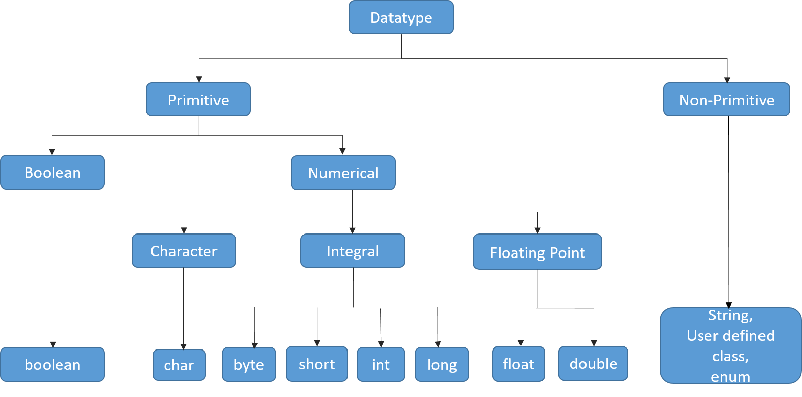
Let us have look at different data types in the below diagram in detail.

Slide 32
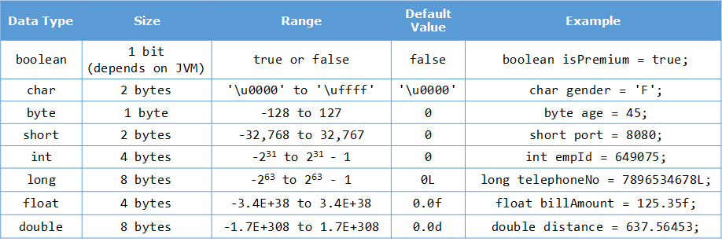
The default value and size occupied by each datatype with an example below.
Next, let us see how we can specify the datatype of a variable.

Slide 33
By now, you have seen that to declare a variable, you need to specify the data type of the variable but from Java 10 onwards, a new feature of local variable type inference has been introduced.
This feature allows you to specify var instead of the data type while declaring a variable as shown below.
var number=11;
In the above code snippet, you can notice that instead of a data type, var has been specified while declaring the variable.
In this case, the compiler infers the data type of the variable based on the value initialized to it.
Here, the compiler will infer the data type as int as an integer value has been initialized to the variable number.
Please note that var can only be used when a variable is initialized during declaration. var cannot be used when a variable is just declared without initialization.
The code snippet given below will result in a compilation error.
var number;

Slide 34
Once a variable declared with var has been initialized, you cannot even change the type of the value assigned
to the variable.
var number=11; //Line 1
number="Java"; //Line 2
The above code snippet will result in a compilation error as in Line 2, the value 'Java' of type String is assigned to the variable number but initially the type inferred for the variable number was int. This is not allowed.
Similarly a var variable cannot be initialized to null, which will result in compilation error if done. This is because it cannot determine the type of the variable from the value null.
var number=null;
You can now try these out in tryouts given later.
Let us discuss about operators next.
To manipulate variables and to do some operations on the data, we require operators.
Operators are symbols that perform specific operations on values and return a result. Java is loaded with a huge set of operators:

Slide 35
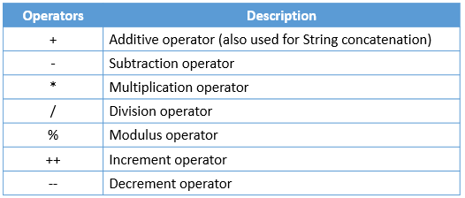
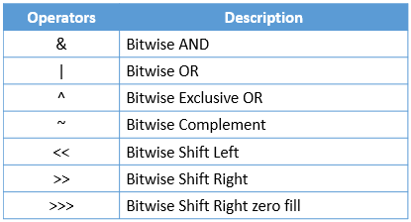
Arithmetic operators:
Bitwise operators:

Slide 36
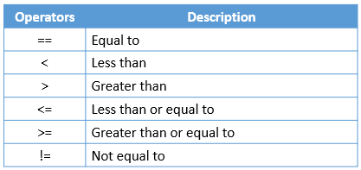
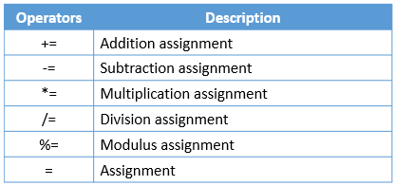
Relational operators:
Assignment operators:

Slide 37
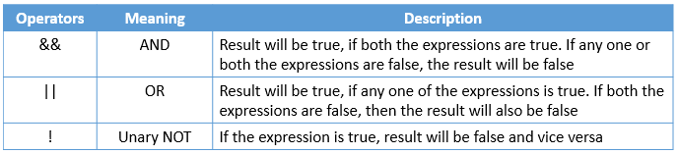
Logical operators:
Ternary Operator: It is a short form of if-then-else statement
Syntax: <condition> ? <statement if true> : <statement if false>;
For Example:
int a=30, b=50;
String result= a>b?"A is greeter is greater";

Slide 38
Use JShell to execute the below code
int pizzaPrice=280;
int quantity=2;
long totalCost = pizzaPrice * quantity;
if(totalCost>2000 && totalCost<=10000){
float totalCostWithDiscount = totalCost - (totalCost * (float)5/100);
}
else if(totalCost>10000){
float totalCostWithDiscount = totalCost - (totalCost * (float)10/100);
}
else{
System.out.println("No Discount");
}
Next, let us see how we can assign a value from one data type to another.

Slide 39
In Java, type conversion or type casting refers to the process of assigning a value from one data type to another. In most cases, to prevent the loss of information, any of the operand's value can be converted to a higher accommodating type.
Java supports two types of type conversion:
Explicit type casting
Explicit conversions are generally used to prevent data loss in mathematical operations. Also, when a value of larger data type needs to be stored as a value of smaller data type, despite the possibility of data loss, we should explicitly specify the conversion. In such a case, it is called narrowing conversion.
For Example:
float totalCostWithDiscount = totalCost - (totalCost * (float)5/100); // Explicit Type Casting
Implicit type casting
Implicit conversion happens when a value of smaller data type needs to be used as a value of larger compatible data type.
For Example:

Slide 40
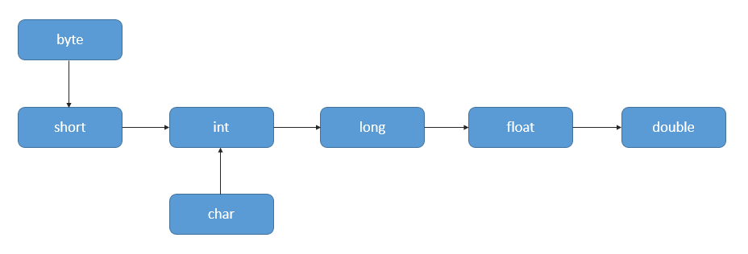
int intValue = 1002;
long longVariable = intValue;
//Here type casting is automatically done
Also called widening conversion, it is done automatically by Java. It follows the sequence below:
Next, let us see few tryouts on datatypes, var and operators.

Slide 41
Datatypes and var -Tryout
Problem Statement :
Play around with different data types and get familiar with declaring and initializing variables.
Data types are primarily of two kinds:
Primitive data types: Variables hold the value of data item. In Java char type uses Unicode characters
Non-Primitive/Reference data types: Variables hold the reference of the memory location where the data item is stored. Example: String
Java has var keyword to declare variables, which allows you to declare a variable without their type.
Below code is a simple Java program to demonstrates different ways of declaring and initializing a variable in Java

Slide 42
class DataTypesDemo{
public static void main(String[] args) {
int price = 100; //primitive data type
double discount = 25.5;
String size = "Medium"; //non-primitive data type
System.out.println("Prize after discount: "+price*(1-discount/100));
//Variable declared using var keyword
var customerName = "Rob Jones"; // infers String
System.out.println( customerName +" ordered a "+size+" pizza");
}
}

Slide 43
Local Variable Type Inference - Tryout
Problem Statement:
Try executing the code given below to understand local variable type inference. Uncomment the code and observe the result, to understand better.
class Tester{
public static void main(String[] args){
//Variable declared using var instead of data type
var numberOne=11; //The type of the variable is inferred by the compiler
System.out.println("The value of numberOne is "+numberOne);
//Uncomment the code given below and observe the output
//var numberTwo;
//Uncomment the code given below and observe the output
//numberOne="Java";
}
}

Slide 44
Operators tryout
Problem Statement :
The code given below demonstrates the use of operators
Let’s see code ..

Slide 45
class Tester {
public static void main(String[] args) {
int year = 1900;
boolean leap = false;
if(year % 4 == 0){
//since every 100th year is not a leap year, so
if(( year % 100 == 0) && (year%400==0))
//checking for century year is leap year or not
leap = true;
else if(year % 100 != 0)
leap = true;
else
leap = false;
}
else
leap = false;
if(leap)
System.out.println(year + " is a leap year.");
else
System.out.println(year + " is not a leap year.");
}
}

Slide 46
Keywords and DataTypes - Exercise
Problem Statement:
Here is a program to convert temperature from Fahrenheit to Celsius.
To do: Add code to convert the temperature to Kelvin.
class DataTypeDemo
{
//The method converts temperature from one unit to another
public static void main(String[] args) {
double fahrenheit = 212.0; // Input in Fahrenheit
double celsius =(( 5 *(fahrenheit - 32.0)) / 9.0); // conversion from fahrenheit to celsius
System.out.println(fahrenheit + " degree Fahrenheit is equal to " + celsius + " in Celsius");
//Write code here to convert temperature to Kelvin
}
}

Slide 47
Introduction to Class
As we have seen, Java follows Object Oriented Programming concepts and classes and objects are basic concepts of Object Oriented Programming which revolve around the real-life entities.
A class is a design or blueprint that describes the characteristics and behaviors of a real-time entity. In other words, the class is a user-defined data type in Java.
It starts with the keyword "class" followed by a name.
It specifies attributes (characteristics) and methods (behaviors).
Attributes are the elements (instance variables) which hold the values of a particular entity that define its characteristics.
Methods are the sets of instructions that define the behaviors of the entity.

Slide 48
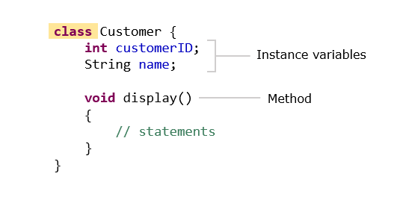
An example of creating a class can be seen below,
In the above class definition, we can see that the attributes are the variables of the class. But what is a method and what is its importance in a class?
So, let us discuss about methods next.

Slide 49
A method is a set of statements which depicts the behavior of a class. We have already encountered the
main method.
To execute any program, the compiler always needs an initial/entry point to start from. In case of Java programs, that initial/entry point is marked by the main()method present in the program. Without this method, the JVM cannot start executing the program. The syntax can be given as:
public static void main(String[] args){
//statements
}
public: This specifies the level of access of the method within and outside the program. And to make main() method visible to JVM, the level of access must be set to "public". If the same is anything except public (private, protected or default) the JVM will be unable to see the initial/entry point of the program. And hence the program will not run.
static: Generally, a Java program is in the form of a class. And whenever we create classes in Java, we need to create instances/objects to access the class methods and attributes. The same applies to main() method also. But by declaring a class method as "static", we can call the method without creating instances of the class. Hence we declare the main() method as static.

Slide 50
void: In Java, every method is expected to return a value of any type (integer, double, string etc.). And to make a method not return any value, it must be declared "void". Since the main() method is not expected to return any value, it must be declared as void.
main(): As discussed above, a Java program is basically a class. And the main() method is the default method of this class. This method marks the initial/entry point of the Java program.
String args[]: Now a program in general may take inputs from the users. In Java, they are usually in the form of multiple strings as "command line arguments" grouped as an array of string. This string array is taken as the argument in the main() method.
Now, let us define a method.

Slide 51
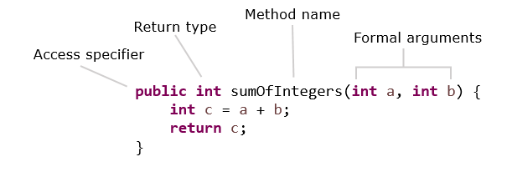
A method definition looks as shown below :
The first line of the method contains the method signature, which includes the name of the method and the arguments (parameters) it takes.
Methods need to be called or invoked to execute the statements present inside the method.

Slide 52
The code given below demonstrates a method and the way to call or invoke the method.
public class Calculator {
// Method definition - here, numberOne and numberTwo are formal parameters or arguments
int calculateSum(int numberOne, int numberTwo) {
return numberOne+numberTwo;
}
}
public class Tester {
public static void main(String[] args) {
Calculator calculator=new Calculator();
int numberOne=11;
int numberTwo=1;
//Method call - here, numberOne and numberTwo are actual parameters or arguments
int sum=calculator.calculateSum(numberOne, numberTwo);
System.out.println("The sum is "+sum);
}
}

Slide 53
Arguments of a method are optional. The arguments specified in the method definition are called formal arguments or parameters. The arguments or parameters that are used in the method call are known as actual arguments or parameters.
Methods may or may not return a value after execution.
The return keyword is used to return a value from the called method to the calling method.
The return type specifies the data type of the value to be returned.
If a method does not return anything, the return type should be specified as void.
In the code given above, the value returned by the method will be stored in the variable sum.
Next, let us see how to create objects.

Slide 54
Object Creation
Till now we have learnt to create a class. A Java class, is a blueprint so how do we use it? It can be done by providing some values to the attributes of the class. This is called the instantiation of a class and the entity we get after instantiation is called the object.
An object is an instance of a class.
It allows us to use the attributes and behaviors specified in the class.
A class can have any number of objects.
An object holds data related to one instance of a class.
In Java, an object is created by using the new keyword.

Slide 55
Let's create an object for the Customer class shown below:
class Customer {
String customerName;
// getter method - returns the customerName of the object
String getCustomerName() {
return customerName;
}
//setter method - sets the customerName of object to the specified value
void setCustomerName(String customerName) {
this.customerName = customerName;
}
}
An object for the class can be created as shown below:
Customer customerObject = new Customer();

Slide 56
Methods and attributes can be invoked by using the "." operator:
customerObject.customerName = "Ron";
System.out.println("Hello "+customerObject.getCustomerName()); //Output : Hello Ron
// To change the name we use setter method
customerObject.setCustomerName("Jack");
System.out.println("Hello "+customerObject.getCustomerName()); //Output : Hello Jack
Note :
During object creation, the instance variables are automatically assigned default values (for example: 0 for integer, 0.0 for double, null for String etc.) based on their respective datatypes.
Local variables declared inside methods have to be initialized with relevant values before they can be used.
Looking at the object creation, do you notice that we are calling a function having the same name as that of our class? We have created only one method in the Customer class, i.e., display(). There is no function with the name Customer(). So how are we calling it?
Let us see a tryout on objects next.

Slide 57
Constructor and this keyword
A constructor is a method which has the same name as the class. It is a special method as it does not return any value, and is used for creating objects and initializing their values.
Syntax:
<<classname>>(){ }
For Example:
//Constructor
Customer(){ }
//Constructor above is called while creating objects as shown below,
Customer custObj = new Customer();
Here, Customer() indicates constructor invocation during object creation

Slide 58
Types of constructors:
Non-Parameterised/Default constructor
A constructor which doesn't take any parameter
If the programmer doesn't provide any constructor, a non-parameterized/default constructor will be provided by the compiler.
Parameterised Constructor
A constructor which accepts parameters (arguments)
//Parameterised constructor
Customer(int customerId) {
System.out.println(customerId);
}
//Constructor above is called while creating objects as shown below,
Customer custObj = new Customer(1001);
Note: If the programmer provides a parameterized constructor then the default constructor is not provided by the compiler.
Next, let us learn about the 'this' keyword.

Slide 59
Now let us consider a situation where a method has an argument or a local variable which has its name similar to an instance variable. Who gets the higher preference, the local variable/argument or the instance variable?
Surprisingly, the local variable gets the higher preference than the instance variable inside the method. And this is known as shadowing of a field. So, how do we use both the instance variable and the local variable/argument together?
How do we call any constructors or methods of a class, from a method of the class?
class Customer{
String customerName;
public Customer(String customerName) {
customerName = customerName;
}
public void display () {
System.out.println("Customer Name : "+customerName); // Output :- Customer Name : null
}
}
public class Tester {
public static void main(String[] args) {
Customer customer1 = new Customer("Jack");
customer1.display();
}
}

Slide 60
Here, the variable 'customerName' used in the constructor is local to that constructor. The instance variable (customerName) name will remain null. To assign the value passed into the constructor to the instance variable 'customerName' and to call the display() method, this keyword can be used as shown below:
class Customer{
String customerName;
public Customer(String customerName) {
this.customerName = customerName;
}
public void display () {
System.out.println("Customer Name : "+customerName); // Output :- Customer Name : Jack
}
}
As we have learnt to invoke attributes using this, can we invoke methods using this? Let us see how to do that next.

Slide 61
this keyword is also used to invoke the constructor or any method of the current object.
Observe the code given below:
public class Customer {
public String customerId;
public String customerName;
public long contactNumber;
public String address;
public Customer() {
System.out.println("Parameterless constructor called");
}
public Customer(String customerId, String customerName, long contactNumber,
String address) {
// this() is used to invoke the constructor of the current class
// Since no parameters are specified, parameterless constructor will be invoked
this();
this.customerId = customerId;
this.customerName = customerName;
this.contactNumber = contactNumber;
this.address = address;
}
See the continuing code in next ..

Slide 62
public void displayCustomerName() {
System.out.println("Customer Name : " + customerName);
}
public void displayCustomerDetails() {
System.out.println("Displaying customer details \n***********");
System.out.println("Customer Id : " + customerId);
//this is used to invoke method
this.displayCustomerName();
System.out.println("Contact Number : " + contactNumber);
System.out.println("Address : " + address);
}
}

Slide 63
We will create a Tester class for the same, which will have input as follows:
public class Tester {
public static void main(String[] args) {
Customer customer = new Customer();
customer.displayCustomerName();
customer.displayCustomerDetails();
Customer customer1 = new Customer("K123","Katy",7865l,"21A, Downtown, LA");
customer1.displayCustomerName();
customer1.displayCustomerDetails();
}
}
For an object customer, we are calling parameterless constructor which is printing the statement "Parameterless constructor called" and is not setting any attributes, hence it will set them to null. And customer1 is calling the parameterized constructor which is calling parameterless constructor (using this() ) and setting the value of the attributes.

Slide 64
After executing the above code we will get the output as :
Parameterless constructor called
Customer Name : null
Displaying customer details
***********
Customer Id : null
Customer Name : null
Contact Number : 0
Address : null
Parameterless constructor called
Customer Name : Katy
Displaying customer details
***********
Customer Id : K123
Customer Name : Katy
Contact Number : 7865
Address : 21A, Downtown, LA
You can further explore this concept in the tryout.

Slide 65
Class Diagram
By now you learnt how to create a class, its attributes or instance variables, methods and constructors. It is also important to understand how to represent them so that anyone can understand about the class even without comprehensive knowledge in programming languages. Class diagrams helps in achieving this.
Class diagrams are used for diagrammatically representing the classes, its structure and relationship with other class.
Class diagram mainly describes the attributes and methods of a class. Relationships and the dependencies between Java classes, interfaces, enums, fields, methods, references etc. can also be modelled using a class diagram.
It also helps in constructing executable code of an enterprise application. Class diagram is the only UML (Unified Modeling Language) diagram which can be directly mapped to object-oriented languages and therefore, is one of the most widely used UML diagrams.
In UML class diagrams, a class is represented by a rectangular box with its class name on top and divided into different sections. The first section represents all the attributes of the class and the second represents methods.

Slide 66
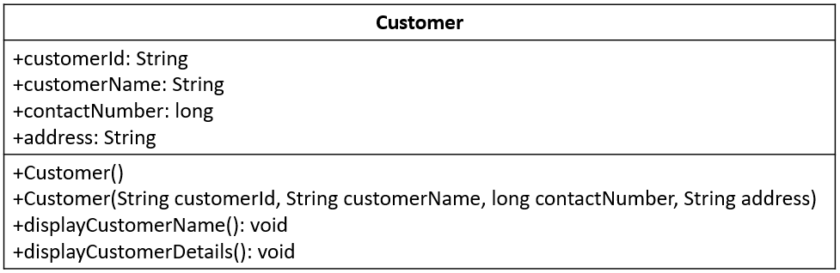
Below is the UML class diagram of a class Customer which we discussed in the previous tryout.
The symbol + denotes that the members of the class are publicly accessible. Similarly, there are other symbols representing accessibility of members.

Slide 67
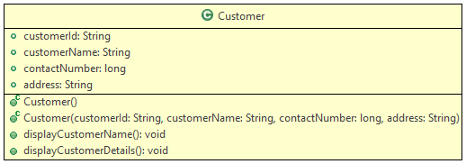
Class diagrams can also be generated using IDEs.
Below is the class diagram for the class Customer, generated using Eclipse IDE.
Each symbol has its own meaning as per the access modifier and the type of attributes and methods.
The green color represents the class or its variables are having public accessibility.

Slide 68
Coding Standards
Now that we have seen how we can work with classes and objects, let us discuss few coding standards that are followed in Java.
Java follows certain conventions when it comes to naming variables, packages, classes, methods, and interfaces i.e. identifiers. The programs are more understandable if meaningful names are provided for the identifiers. The following conventions are followed:
Identifiers can contain alphabets, numbers, underscore( _ ), and the dollar sign. ( $ ). There is no restriction in the length.
Reserved keywords should not be used for naming identifiers.
Class names should follow PascalCasing i.e the first letter and the first letter of each internal word should be capitalized. Example: StringBuffer, EmployeeDemo
Method names should follow camelCasing i.e the first letter should be in lowercase and the first letter of each internal word should be in uppercase. Example: display, getEmployeeName
Variable names should start with lowercase and the first letter of the subsequent words should be in uppercase. Example: total, averageCount
Constants should be in uppercase with each word separated by an underscore. Example: PI, MIN_LENGTH
Let us discuss few other concepts such as control structures next.

Slide 69
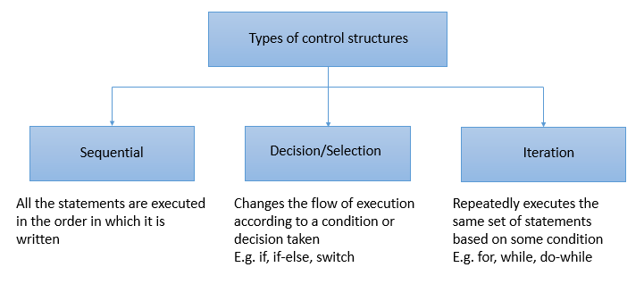
Control Structure
In a program, the instructions are usually executed line by line. Sometimes, all the statements in a program may not be executed. There can be a change in the flow of control and can be implemented using control structures.

Slide 70
The selection control structures available in Java are:
if-else
if-else if
Switch
The iteration control structures available in Java are:
while loop
do-while loop
for loop
for-each loop

Slide 71
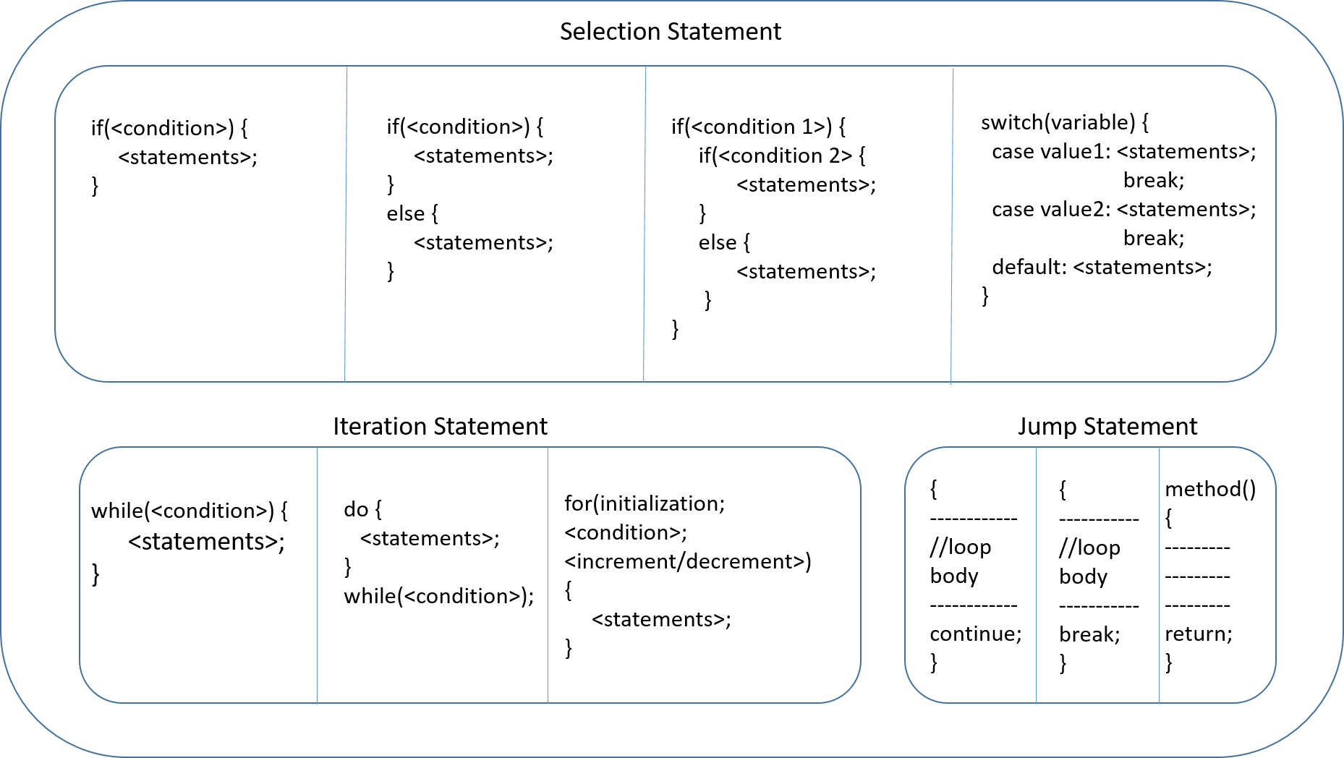
The syntax of the various control structures is given below.

Slide 72
If Else - Tryout
Problem Statement :
The code given below checks whether a given number is even or odd using if-else block. Execute the code by assigning different values to number variable.
//Java program to check whether the given number is even or odd
//Observe the output for different values of a number variable
class Tester {
public static void main(String[] args) {
int number = 5;
if (number % 2 == 0) {
// This block will get executed if the if-condition is true
System.out.println(number + " is an even number");
} else {
// This block will get executed if the if-condition is false
System.out.println(number + " is an odd number");
}
}
}

Slide 73
Problem Statement:
The code given below displays the grade of a student based on the marks using if-elseif blocks.
Execute the code with different values of marks and observe the output.
//Observe the output for different values of marks
class Tester {
public static void main(String[] args) {
int marks = 90;
if (marks < 50) {
System.out.println("Fail");
} else if (marks >= 50 && marks < 60) {
System.out.println("D grade");
} else if (marks >= 60 && marks < 70) {
System.out.println("C grade");
} else if (marks >= 70 && marks < 80) {
System.out.println("B grade");
} else if (marks >= 80 && marks < 90) {
System.out.println("A grade");
} else if (marks >= 90 && marks <= 100) {
System.out.println("A+ grade");
} else {
System.out.println("Invalid!");
}
}
}

Slide 74
Switch - Tryout
Problem Statement:
Execute the code given below and observe the output. Modify the code to get 5% discount for Regular customer and 10% for Premium customer. Also, try changing sequence of the cases, observe how it works if default is written before other cases.
//Observe the output for different values of customerType
class Tester {
public static void main(String[] args) {
double discount;
String customerType = "Premium";
switch (customerType) {
case "Regular":
discount = 5;
case "Premium":
discount = 10;
default:
discount = 0;
}
System.out.println("Customer has got discount of " + discount + "%");
}
}

Slide 75
While - Tryout
Problem Statement
Below try out to calculate the sum of all digits in a given number using while loop.
//Observe how to obtain sum of all digits in a Number
class Tester {
public static void main(String[] args) {
int inputNumber = 7865; //Supply different inputs here
int sumOfDigits = 0;
int temp = 0;
while (inputNumber > 0) {
temp = inputNumber % 10;
sumOfDigits += temp;
inputNumber = inputNumber / 10;
}
System.out.println("Sum of digits are : " + sumOfDigits);
}
}

Slide 76
Do While - Tryout
Problem Statement
Try the below code to calculate the sum of all digits in a given number using do-while loop.
//Observe how to obtain sum of all digits in a Number
class Tester {
public static void main(String[] args) {
int inputNumber = 9654; //Supply different inputs here
int sumOfDigits = 0;
int temp = 0;
do {
temp = inputNumber % 10;
sumOfDigits += temp;
inputNumber = inputNumber / 10;
} while (inputNumber > 0);
System.out.println("Sum of digits : " + sumOfDigits);
}
}

Slide 77
For loop- Tryout
Problem Statement
Below code is used to generate the customerId using for loop. Observe the output.
The usage of var in declaring the variable to be initialized inside a for loop is also demonstrated.
class Customer {
public static void main(String[] args) {
// The below code generates customerId
int totalNoOfCustomers = 12;
String customerId = "";
for (int counter = 1; counter <= totalNoOfCustomers; counter++) {
if (counter <= 9)
customerId = "C0" + counter;
else
customerId = "C" + counter;
System.out.println("Customer Id for customer " + counter + " is "
+ customerId);
}
// Uncomment the below given code and execute it instead of above for loop
// for understanding the usage of var in a for loop
/*
for (var counter = 1; counter <= totalNoOfCustomers; counter++) {
if (counter <= 9)
customerId = "C0" + counter;
else
customerId = "C" + counter;
System.out.println("Customer Id for customer " + counter + " is "
+ customerId);
}*/
// The local variable used in the for loop is declared using var
// type of that variable will be inferred based on the value initialized
}
}

Slide 78
For Each loop - Tryout
Problem Statement:
Below code to is used to calculate the sum of even numbers in an array. Execute the code and observe the output.
The usage of var in declaring the local variable inside a for-each loop is also demonstrated.
//Observe how to obtain sum of even numbers in an array
class Tester {
public static void main(String[] args) {
int[] numbers = {68,79,86,99,23,2,41,100};
int sum=0;
//for-each loop (Enhanced for Loop)
for(int number:numbers) {
if(number%2==0)
sum+=number;
}
// Uncomment the below given code and execute it instead of above loop
// for understanding the usage of var in a for-each loop
/*
for(var number:numbers) {
if(number%2==0)
sum+=number;
}*/
// The local variable used in the for-each loop is declared using var
// type of that variable will be inferred based on the values inside the array
System.out.println("Sum of even numbers: "+sum);
}
}

Slide 79
Package
Imagine walking into a library to get your favorite novel, but welcomed by a room full of an unorganized stack of books. Would you still go ahead and search for the novel?
Of course not!
Just as books are cataloged and arranged in a library, it is important for us to organize our Java files. This can be done with the help of packages.
A package is a set of logically related classes.
A package helps in controlling access and avoiding name conflicts among them.
You need to provide unique names to packages inside a project.

Slide 80
How would you name a package?
The convention for naming packages is to use all lower case alphabets. This is done to avoid conflicts with names of classes.
Also, organizations use reverse internet domains for naming packages.
E.g. - A package created for an internal application of Infosys can be named as com.infy.
Now that you know about the package and its naming convention, you will now see how to create a package.

Slide 81
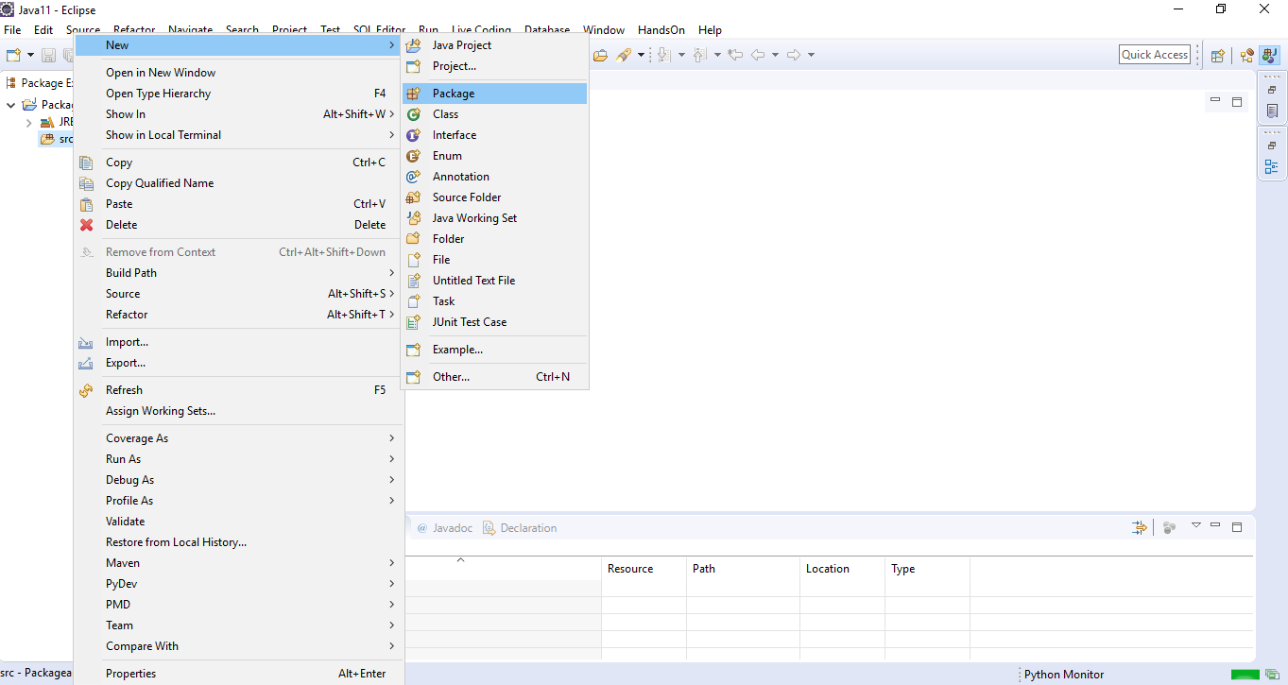
To create a package, right-click on src and select New>Package to create a new package as shown below.

Slide 82
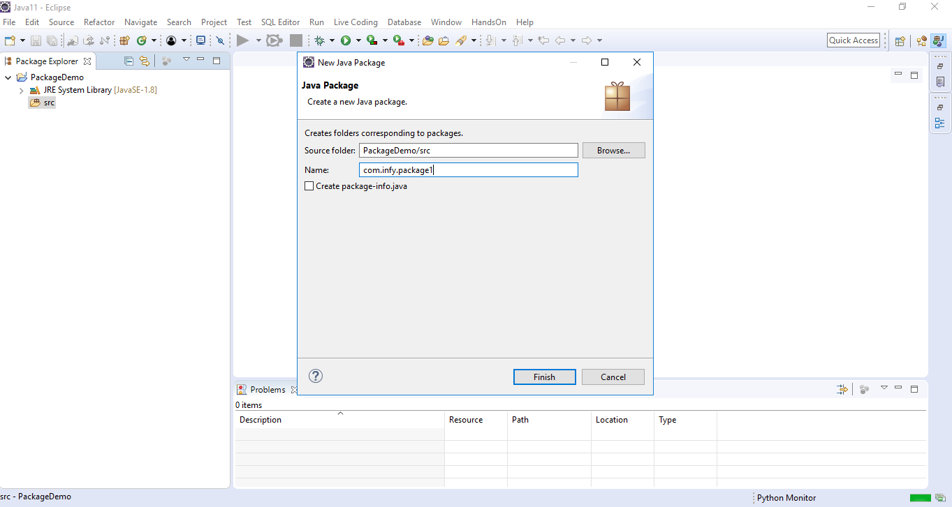
Next, you need to provide a name to the package as shown below

Slide 83
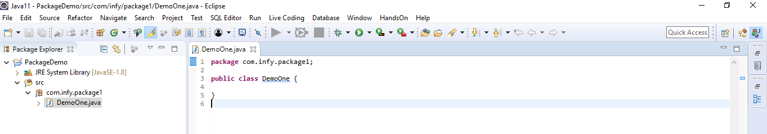
The package is named as 'com.infy.package1' in the screenshot given above. Please observe that each alphabet is in lower case and also reverse internet domain has been used while naming the package.
Once a class is created inside a package, the package keyword specifies the name of the package as shown below. This should be the first line of a .java file.
Classes of one package can also be used in other packages.
How do you use classes of one package in another package?
To use a class of one package in another package, an import statement needs to be used which will be demonstrated to you through a demonstration shown later.
Let us discuss access modifiers next.

Slide 84
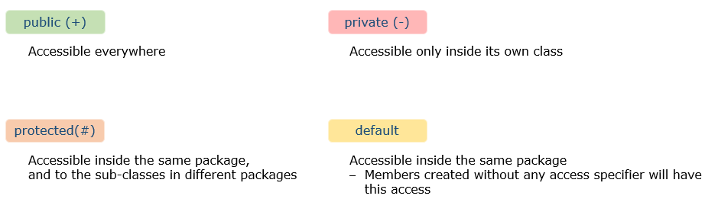
Access Modifiers
Now that you have understood packages, let us also discuss access modifiers.
You would have seen the keyword 'public' in multiple places. The keyword public is an access modifier.
Access modifiers are used to control the visibility of a class and its members. This facilitates encapsulation.
There are 4 access modifiers in Java - public, private, default and protected.
Out of these 4, you will learn more about protected later in the course.
Note: A class can have only public or default access.

Slide 85
Since you have now learnt about the different access modifiers, we will see how they are represented in class diagrams.
Consider the below code snippet for the class Customer.
Let’s see in next slide..

Slide 86
public abstract class Customer {
public String customerId;
protected String customerName;
long contactNumber;
private String address;
private static int idCounter;
public Customer() {
System.out.println("Parameterless constructor called");
}
public Customer(String customerId, String customerName, long contactNumber, String address) {
this.customerId = customerId;
this.customerName = customerName;
this.contactNumber = contactNumber;
this.address = address;
}
public void displayCustomerDetails() {
System.out.println("Displaying customer details \n***********");
System.out.println("Customer Id : " + this.customerId);
System.out.println("Customer Name : " + this.customerName);
System.out.println("Contact Number : " + this.contactNumber);
System.out.println("Address : " + this.address);
}
public String updateCustomerContact(long newContact) {
String message = null;
if (this.contactNumber != newContact) {
this.contactNumber = newContact;
message= "Contact updated";
}
else
message = "Provide a new contact";
return message;
}
public abstract void calculateFinalPrice();
}

Slide 87
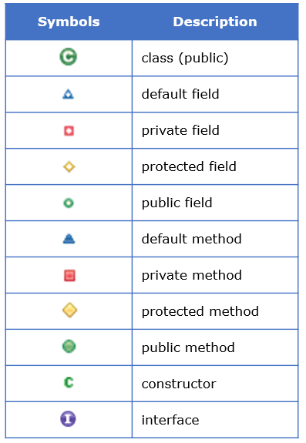
Below is the class diagram for the above given Customer class.
Different symbols used in the above class diagram is explained below:

Slide 88
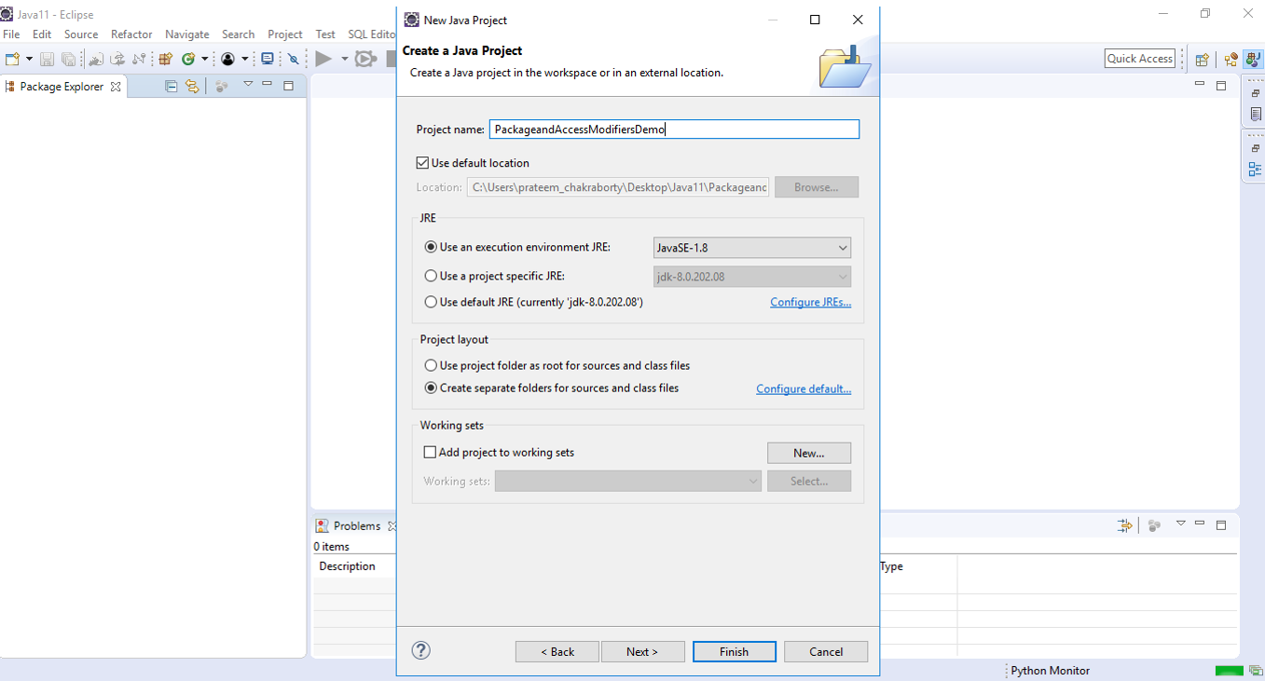
Package and Access Modifiers – Demo
Please follow the steps given below to understand packages and public, private and default access modifiers in Java.
Step 1: Create a project named PackageandAccessModifiersDemo as shown below.

Slide 89
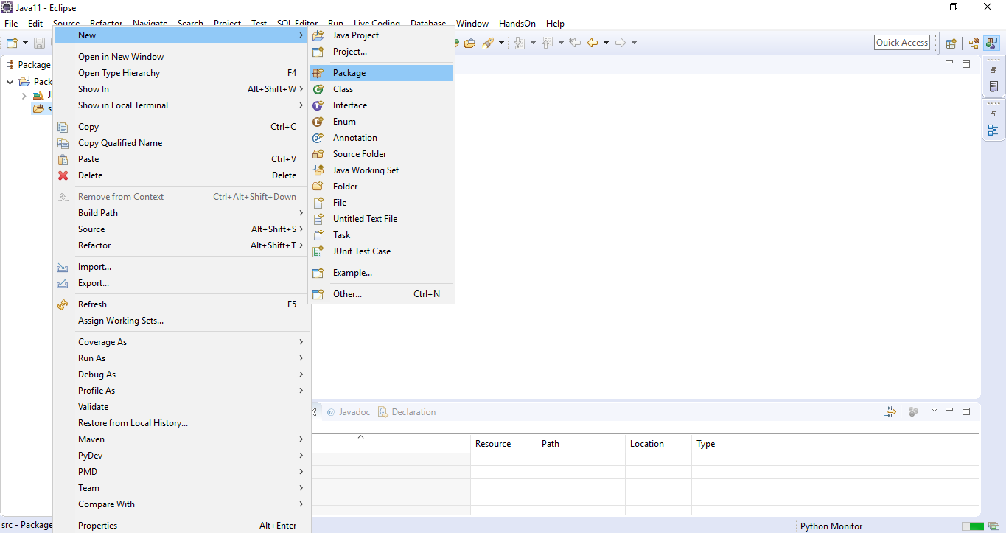
Step 2: Right click on src and select New>Package to create a new package as shown below.

Slide 90
Name the package as com.hnd.package1.
Step 3: Right click on the package name and select New>Class to create a new class in com.cap.package1
Name the class as DemoOne.
Step 4: Create three variables named variableOne, variableTwo and variableThree with public, private and default access modifiers respectively in the class DemoOne.
public class DemoOne {
public int variableOne;
private int variableTwo;
int variableThree;
}
Step 5: Add another class named DemoTwo in com.hnd.package1.
Step 6: Create a method checkAccessibility as shown below in the class DemoTwo. This method will be used to check the accessibility of the variables of class DemoOne in class DemoTwo.

Slide 91
public class DemoTwo {
public void checkAccessibility() {
}
}
Step 7: Create an object of class DemoOne in the method checkAccessibility as shown below.
public class DemoTwo {
public void checkAccessibility() {
DemoOne demoOne=new DemoOne();
}
}
Step 8: Try to access and initialize variableOne in the method checkAccessibility() as shown below.
public class DemoTwo {
public void checkAccessibility() {
DemoOne demoOne=new DemoOne();
demoOne.variableOne=1;
}
}

Slide 92
You can observe that variableOne of class DemoOne is accessible in the class DemoTwo as variableOne is public and hence, can be accessed anywhere.
Step 9: Now, try to access variableTwo in the method checkAccessibility() as shown below.
public class DemoTwo {
public void checkAccessibility() {
DemoOne demoOne=new DemoOne();
demoOne.variableOne=1;
demoOne.variableTwo=1;
}
}
you can observe that you get a compilation error stating 'The field DemoOne.variableTwo is not visible' while trying to access variableTwo of class DemoOne in the class DemoTwo as variableTwo is private and hence, can be accessed only within the class in which it is defined.
Step 10: Now, try to access variableThree and initialize it in the method checkAccessibility() as shown below.

Slide 93
public class DemoTwo {
public void checkAccessibility() {
DemoOne demoOne=new DemoOne();
demoOne.variableOne=1;
demoOne.variableThree=1;
}
}
You can observe that variableThree of class DemoOne is accessible in the class DemoTwo as variableThree is default and hence, can be accessible anywhere within the same package.
Step 11: Add another package named com.hnd.package2 in the same project.
Step 12: Create a class named DemoThree in com.hnd.package2.
Step 13: Create a method checkAccessibility as shown below in the class DemoThree. This method will be used to check the accessibility of the variables created in class DemoOne in class DemoThree.
public class DemoThree {
public void checkAccessibility() {
}
}

Slide 94
Step 14: Create an object of class DemoOne in the method checkAccessibility as shown below.
public class DemoThree {
public void checkAccessibility() {
DemoOne demoOne=new DemoOne();
}
}
You will now observe a compilation error stating 'DemoOne cannot be resolved
This error is coming as the classes DemoOne and DemoThree are present in different packages.
Step 15: To use or access the class DemoOne in the class DemoThree, you can use com.cap.package1.DemoOne, i.e., <package_name>.<class_name> as shown below.
public class DemoThree {
public void checkAccessibility() {
com.hnd.package1.DemoOne demoOne=new com.hnd.package1.DemoOne();
}
}

Slide 95
In this approach, you have to use the fully qualified name (<package_name>.<class_name>) every time you need to access the class. Hence, this is not a recommended approach.
Instead, it is recommended to import the required classes using import statement.
Step 16: Import the class named DemoOne from com.infy.package1 to com.hnd.package2 using the import statement as shown below.
package com.hnd.package2;
import com.hnd.package1.DemoOne;
public class DemoThree {
public void checkAccessibility() {
DemoOne demoOne=new DemoOne();
}
}
To import all the classes present inside a given package, import <package_name>.* can be used.
If you use <package_name>.*, then all the classes of the package will be imported but the classes present inside the sub packages will not be available for use.

Slide 96
Step 17: Now that you have imported class DemoOne in com.hnd.package2, try to access variableOne and initialize it in the method checkAccessibility() as shown below.
public class DemoThree {
public void checkAccessibility() {
DemoOne demoOne=new DemoOne();
demoOne.variableOne=1;
}
}
You can observe that variableOne of class DemoOne is accessible in the class DemoThree as variableOne is public and hence, can be accessed anywhere.
Step 18: Now, try to access variableTwo in the method checkAccessibility() as shown below.
public class DemoThree {
public void checkAccessibility() {
DemoOne demoOne=new DemoOne();
demoOne.variableOne=1;
demoOne.variableTwo=1;
}
}

Slide 97
You can observe that you get a compilation error stating 'The field DemoOne.variableTwo is not visible' while trying to access variableTwo of class DemoOne in the class DemoThree as variableTwo is private and hence, can be accessed only within the class in which it is defined.
Step 19: Now, try to access variableThree and initialize it in the method checkAccessibility() as shown below.
public class DemoThree {
public void checkAccessibility() {
DemoOne demoOne=new DemoOne();
demoOne.variableOne=1;
demoOne.variableThree=1;
}
}
You can observe that you again get a compilation error stating 'The field DemoOne.variableTwo is not visible' while trying to access variableThree of class DemoOne in the class DemoThree as variableThree is default and hence, can be accessed only within the package in which it is defined.
So, through this demo, you would have understood the scope of the different access modifiers and how to access a class of one package in another using import statement.

Slide 98
String class
Next, we will look at some of the built-in classes available in Java.
The first built-in class that we will see is the String class.
As we all know already, a sequence of characters can be stored using a variable of String.
There are two ways to create a string:
String literal
E.g. String customerName = "Jasmine";
Using new() keyword
E.g. String customerName = new String("Jasmine");
In the following demo, we will understand how to create string in two ways.

Slide 99
//String creation using = operator
String name = "Jasmine";
//String creation using new()
String customerName = new String("Jasmine");
System.out.println(name); //Output: Jasmine
System.out.println(customerName); //Output: Jasmine
String methods:
Java String class provides a collection of built-in methods which help in performing various operations on string.
Some of which are:

Slide 100
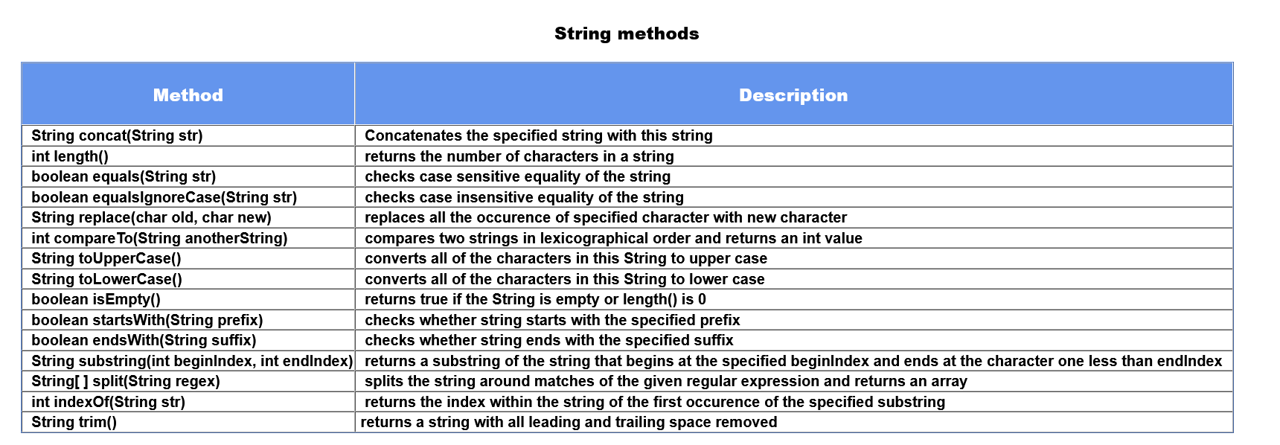

Slide 101

Few of the methods that are introduced since Java 11 are:
All these methods will be discussed in the tryout.

Slide 102
In the demo given below, we compare two strings using equals and equalsIgnoreCase method. We manipulate the given string using methods like replace() and concat(). Similarly, using other methods we can manipulate the strings.
String name = "Thomas";
String customerName = new String("THOMAS");
boolean result1 = name.equals(customerName); // result1 = false
boolean result2 = name.equalsIgnoreCase(customerName); //result2 = true
String username = name.concat("#24"); // will concatenate #24 to name i.e Thomas#24
String newString = customerName.replace("M", "m"); // Will replace all occurence of M to m
// i.e THOmAS
In the next page we will discuss the immutable nature of string and will figure out an alternative to String.

Slide 103
Consider a scenario, where we have to modify the variable name = "Oliver" to "Oliver Carter". To implement this we will use concat method as shown below.
String name = "Oliver";
name.concat(" Carter");
System.out.println(name); //Output Oliver
In the above example, we have string "Oliver" referred by the variable name. Even after using concat, name("Oliver") is not changed, rather a new object is created "Oliver Carter", having no reference. This is because String in Java is immutable. Immutable means which cannot be changed.
To solve this we will use a mutable class known as StringBuilder. StringBuilder class consists of the append method that concatenates the string with the specified argument which might solve our problem. Let's learn more about StringBuilder Class.

Slide 104
StringBuilder Class
StringBuilder Objects are similar to String objects but they can be modified hence they are mutable. This means if we try to modify the original string, a new string will not be generated instead original string will get changed. In one way we can say that StringBuilder will reduce memory usage. It provides an alternative to the String class, it is mutable and easy to use.
The creation of StringBuilder object is shown below
//create StringBuilder object
StringBuilder name = new StringBuilder();
name.append("Oliver");
name.append(" Carter");
System.out.println(name); //Output: Oliver Carter
As given in the code, we can modify the object using the append method and can create StringBuilder objects in a different way. We will discuss some of the methods of StringBuilder.

Slide 105

Some of the most used methods of StringBuilder are given as follows:-
The implementation of these methods will see in the demo given below.
//creation of StringBuilder Object with capacity 50.
StringBuilder name = new StringBuilder(50);
name.append("Mississippi");
int length = name.length(); // will give the length of address
name.insert(length, " River");
System.out.println(name); //Output :- Mississippi River
name.reverse(); // Output :- reviR ippississiM
name.delete(5, 10); // Output :- reviRssissiM
System.out.println(name.charAt(3)); // Output :- i

Slide 106
String methods - Tryout 1
Problem Statement:
Play around with different String class methods for you to explore like concat(), equals(), equalsIgnoreCase(), compareTo().
Uncomment the code as explained and observe the output.
class Tester {
public static void main(String[] args) {
//creation of string using string literal
String firstString = "Java";
//creation of string using new keyword
String secondString = new String("Stream");
/*
Task 1 :- using concat() display Java Stream
*/
System.out.println("------------"+"concat()"+"------------");
System.out.println("Concatenating using concat() :- "+firstString.concat(secondString));
System.out.println();
/*
Task 2 :- string comparison using equals(), == operator, compareTo()
*/
System.out.println("------------"+"Comparison(.equals , == , compareTo)"+"------------");
String thirdString = "Thomas";
String fourthString = "THOMAS";
System.out.println("Comparison of Thomas with THOMAS using equals :- "+thirdString.equals(fourthString));
//string1.equalsIgnoreCase(string2) => case insensitive comparison
System.out.println("Comparison of Thomas with THOMAS using equals ignoring case:- "+thirdString.equalsIgnoreCase(fourthString));

Slide 107
System.out.println();
//using == operator
String fifthString = "Thomas";
String sixthString = new String("Thomas");
System.out.println("Comparison using == operator :- "+(thirdString==fifthString));
//Line 36 both refer to same instance
System.out.println("Comparison using == operator with new keyword :- "+(sixthString==fifthString));
//Line 39 sixthString refers to instance created in nonpool
System.out.println();
//using compareTo()
/*
if s1 and s2 are two strings which are to be compared
if s1 == s2 then output is 0
if s1 > s2 then output is 1
if s1 < s2 then output is -1
*/
System.out.println("Comparison of Thomas and Thomas using comapreTo :- "+(thirdString.compareTo(fifthString)));
System.out.println("Comparison of Thomas and RudolfShelby using compareTo :- "+(thirdString.compareTo("RudolfShelby")));
}
}

Slide 108
Problem Statement:
Here are some new methods of String introduced in Java 11. Some of these methods like repeat(), isBlank(), strip(), stripLeading(), stripTrailing(), lines() are discussed in the tryout.
import java.util.stream.Stream;
class Tester {
public static void main(String[] args) {
System.out.println();
System.out.println("------------"+"Java 11 String methods"+"------------");
String one = "amazon";
System.out.println("Repeat method used to repeat the string having count passed as parameter");
System.out.println("Repeat string one 3 times :-"+one.repeat(3));
System.out.println();
String two = "Antarctica";
System.out.println("isBlank() tells us whether the string contains only Blank spaces");
System.out.println("Checking isBlank() with string two :- "+two.isBlank());
String blank=" ";
System.out.println("Checking isBlank() with string blank :- "+blank.isBlank());
System.out.println();
String whiteSpaceLeadingAndTrailing = " Pacific ";
String whiteSpaceLeading = " Pacific";
String whiteSpaceTrailing = "Pacific ";

Slide 109
System.out.println("In Java 11, we have three methods to remove extra white-spaces\n"
+ "1.strip() => All the leading and trailing white-spaces are removed.\n"
+ "2.stripLeading() => All the leading white-spaces are removed.\n"
+ "3.stripTrailing() => All the trailing white-spaces are removed.\n"
+ "These methods are extension to the trim() method which we have already seen\n");
System.out.println("----Demo----");
System.out.println("Using strip() :- "+whiteSpaceLeadingAndTrailing.strip());
System.out.println("Using stripLeading() :- "+whiteSpaceLeading.stripLeading());
System.out.println("Using stripTrailing() :- "+whiteSpaceTrailing.stripTrailing());
System.out.println();
System.out.println("String.lines() splits the string by its line terminators and returns a Stream of Strings");
String str1 = "A \n B \n C \n D";
System.out.println("Use String.lines() on string str1");
Stream<String> lines = str1.lines();
lines.forEach(System.out::println);
}
}

Slide 110
Problem Statement
Have a look at how mutable strings can be manipulated. Some of its methods like insert(), append(), capacity(), delete(), length() are discussed.
class Tester {
public static void main(String[] args) {
//Creating StringBuilder Objects
StringBuilder strOne = new StringBuilder("Java");
StringBuilder strTwo = new StringBuilder();
strTwo.append("Python");
// method will return length of strOne
Integer length = strOne.length();
//method will insert a new string to the original string
strTwo.insert(0,"I love ");
System.out.println(strTwo);
// method will append 2.0
strOne.append(9.0);
System.out.println(strOne);

Slide 111
//to print the capacity of object we use capacity()
System.out.println(strOne.capacity());
//this method will insert SE into strOne at specified position
strOne.insert(length,"SE");
System.out.println(strOne);
//this method will create a string from start index till end index as specified
String sub = strTwo.substring(4,9);
System.out.println(sub);
//this method can convert StringBuilder Object
String str = strTwo.toString();
System.out.println(str.getClass());
// this method deletes characters from strOne based on the arguments specified
strOne.delete(0,3);
System.out.println(strOne);
}
}

Slide 112

Wrapper Class
All this time, we have been using primitive types. But there are occasions where we need to represent them as Objects. This is where Wrapper classes come into the picture. A wrapper class is the one which contains or wraps the primitive data types (int, char, etc.)
All the primitive data types have their corresponding Wrapper classes. The following table shows the primitive data types and their corresponding Wrapper class.

Slide 113
Wrapper classes also provide a number of useful methods to manipulate values. They belong to the java.lang package as part of the Java library.
Integer wrappedInt = new Integer(2);
Since Java 5, this can be done without an explicit call to the constructor
char value = 'a';
Character wrappedChar = value;
This mechanism is called autoboxing which means automatic conversion of primitive types to the object of their corresponding wrapper classes is known as autoboxing. For example – conversion of char to Character as shown above.

Slide 114
Similarly, there is a process of unboxing which is opposite of autoboxing. In this process automatically conversion of a wrapper class object to its corresponding primitive type is performed. For example refer the
code given below.
char newVal = wrappedChar;
Important Note: Similar to the String pool, Byte, Short, Integer and Long classes cache values in the range -128 to 127.
Next, let us discuss few methods which are present in a wrapper class.

Slide 115
Wrapper Class Methods
Wrapper classes are helpful in converting numeric strings into numeric datatypes (for example String-to-int, String-to-double etc.). And so, we have supporting methods like parseDouble(), parseInt(), etc.
Each such method accepts a string and returns an object of the corresponding data type. Let's look at the Integer class for instance.
String sum = "123";
int mySum = Integer.parseInt(sum);// Here 'mySum' would be holding the integer 123
Also, typecasting fails in converting a wrapper type to another type. So, we can use methods such as intValue(), byteValue(), floatValue() etc. to do such conversions. Let's take a look at the following example:
Integer phoneNo = 44281234;
Long phoneNo = phoneNo.longValue(); // Converts Integer into a Long value
Now we will see some of the methods of Character wrapper class :
We create two objects alphaObj and digitObj as shown:

Slide 116
Character alphaObj = new Character('A');
Character digitObj = new Character('5');
Following are some of the methods which make our task to manipulate the data, easy.
isDigit() - checks if a given character is Digit
isUpperCase() - checks if a given character is LowerCase
toString() - converts Character to String
charValue() - converts Character to char primitive data type
toLowerCase() - converts Character to LowerCase
boolean result1 = Character.isDigit(digitObj); // Output :- true
boolean result2 = Character.isUpperCase(alphaObj); // Output :- true
String val = alphaObj.toString(); // val = "A"
char beta = alphaObj.charValue(); // beta = 'A'
char c = Character.toLowerCase('B'); // c = 'b';

Slide 117
We will see some methods which introduce comparison.
int result11 = Character.compare('A', 'b');
System.out.println(result11); //-33
Character anotherCharacter = new Character('b');
int result22 = alphaObj.compareTo(anotherCharacter);
System.out.println(result22); //-33
As you can see, both the methods are giving the same output then, what is the difference between them?
If you observe both the methods carefully you will come to know, in compare() we are comparing the two char values (In this case 'A' and 'b') and in compareTo() we are comparing two objects of Character wrapper class.

Slide 118
The working of both the methods is given below.
compare() :-
Comparing chars using compare which returns an int
It returns 0 if char1 == char2
a value less than 0 if char1 < char2
a value greater than 0 if char1 > char1
2. compareTo() :-
Comparing Character objects using compareTo which returns int
It returns 0 if obj1 == obj2
a value less than 0 if obj1 < obj2
a value greater than 0 if obj1 > obj2
You will explore more of wrapper class methods in the tryout.

Slide 119
Wrapper Classes - Tryout
Problem Statement :
In this code we will discuss how the Character Wrapper class along with various methods which can be used in different scenarios.
//This program demonstrates usage of various methods in Character Wrapper class
class Tester {
public static void main(String[] args) {
//Creating Character instances using valueOf()
Character alphaObj = Character.valueOf('A');
Character digitObj = Character.valueOf('5');
//method to check if a given character is Alphabet
System.out.println("Z is Alphabet:"+Character.isLetter('Z'));
//method to check if a given character is Digit
System.out.println("5 is Digit:"+Character.isDigit(digitObj));
//method to check if a given character is LowerCase
System.out.println("b is LowerCase:"+Character.isUpperCase('b'));
//method to convert to LowerCase
System.out.println(Character.toLowerCase('Z'));
System.out.println(Character.toLowerCase(66));

Slide 120
//method to convert Character to String
String xobj = Character.toString('x');
System.out.println(xobj);
//method to convert Character to char primitive data type
char alpha = alphaObj.charValue();
System.out.println(alpha);
//Comparing chars using compare which returns int
//It returns 0 if char1 == char2;
//a value less than 0 if char1 < char2;
//and a value greater than 0 if char1 > char1
System.out.println(Character.compare('A', 'b'));
//Comparing Character objects using compareTo which returns int
//It returns 0 if obj1 == obj2;
//a value less than 0 if obj1 < obj2;
//and a value greater than 0 if obj1 > obj2
Character anotherCharacter = Character.valueOf('b');
System.out.println(alphaObj.compareTo(anotherCharacter));
}
}

Slide 121
Arrays
An array is a collection of similar data in contiguous memory locations referred to by the same name. It is an object in Java and is created dynamically.
Syntax:
<data type><variable name>[ ] = new <data type>[size];
(or)
<data type>[ ] <variable name> = new <data type>[size];
Creating, initializing and accessing an array:
We initialize array pizzaCost and add elements to it as shown below.

Slide 122
int pizzaCost[]=new int[3];
pizzaCost[0]=100;
pizzaCost[1]=250;
pizzaCost[2]=390;
To access each element in the array, we are going to use a for loop as shown.
//Accessing elements using for loop
for (int index; index < pizzaCost.length; index++) {
System.out.println(pizzaCost[index]);
}
You can use different loops to iterate and access each element of the array. Example of forEach loop is shown below
//Accessing elements using for-each loop
for (int cost : pizzaCost) {
System.out.println(cost);
}

Slide 123
The type of arrays which we have learned is one dimensional, can we have multi-dimensional arrays?
Have you ever tried to store the data in a matrix?
The solution of the same you will get in the next module.
We can also have multi-dimensional arrays. In simple words, we define multidimensional arrays as an array of arrays. Data in the mutli-dimensional array is stored in the tabular form (you can think of a matrix for better understanding).
Syntax:
<data_type>[1st dimension][2nd dimension][]...[nth dimension] <arrayName> = new <data_type>[size1][size2]….[sizeN];

Slide 124
Now we will see the examples of declaring a multi-dimensional array.
Examples:
Two dimensional array: int[][] 2dArray = new int[10][20];
Three dimensional array: String[][][] 3dArray = new String[10][20][30];
Declaration of the array given above is the direct method of declaration, here we specify the size at the time of declaring an array. To set the values we make use of the dimensions(rows and columns).
For example, see the code given below.
String[][] names = new String[7][3]; // Here, 7 is the row size; 3 is the column size (optional)
// To set value of first row second column
names[1][2] = "Oliver";
// To set value of second row first column
names[2][1] = "Josh";

Slide 125
Now you will see the indirect method of declaring a 2-D array. Consider the array given below having four rows and three columns
// Another way of creating a 2-D array
String[][] names = new String[][] {
{"Robert", "Shelly", "Scarlett"},
{"Mark", "Oliver", "Chris"},
{"Emmy", "Josh", "Merry"},
{"Evelyn", "Austin", "Emma"}
};
To access any element of the array we refer its position i.e. arrayName[row][column].
For example:
String value = names[0][1];
// value = Shelly

Slide 126
Now you will learn how to iterate over the multi-dimensional array.
for(int i=0;i<names.length;i++) {
for(int j=0;j<names[i].length;j++) {
System.out.print(names[i][j]+" "); // where i refers to row
// and j refers to column
}
System.out.println();
}
As you can see, we have used two for loops to iterate over array(names). Outer for loop is used to iterate each row of the 2D array (for better understanding consider it as a 2D matrix) and the inner one iterates over each element in the row.
Now as we have learned the concept of array thoroughly, can we create an array of user-defined objects?
What kind of array that will be? Let us see that next.

Slide 127
An object represents a single record in memory, consider a scenario where we want multiple records (objects) at a time, in that case, you will have to use arrays which will be called as an array of objects. Make a note, arrays can hold the only reference of the objects and not the object. Let us see how to create an array of objects.
Example: Consider a class Account consisting of two attributes account holder's name and its bank account number. We have to show the information of each account holder present in the bank. To make operation easy we have to make use of arrays.
First, in order to use an object, you should define the structure of the class Account.
class Account{
String name;
long accountNumber;
}

Slide 128
Now to perform the required operation we have to define two methods, one for setting the data and others for displaying the information. These methods will be called by the objects every time, to perform the operation.
Accordingly, the structure of the class Account will become as given below:
class Account{
String name;
long accountNumber;
void setData(String custName,int accNum) {
this.name = custName;
this.accountNumber = accNum;
}
void display() {
System.out.println("Name :- "+name);
System.out.println("Account Number :- "+accountNumber);
}
}

Slide 129
Next task is to declare an array, which is shown below:
// creating array of type Account having size 3
Account accArray[] = new Account[3];
After completing the declaration, now comes the part where we have to create an object and set the data (account holder's name and account number).
//first create the object of Account
//and then set the data for each object
accArray[0] = new Account();
accArray[0].setData("Ella",345234);
accArray[1] = new Account();
accArray[1].setData("Scarlet",345278);
accArray[2] = new Account();
accArray[2].setData("Harper",345897);

Slide 130
We can call the method display using these objects individually (accArray[0].display()) as the total number of objects is 5, but what if we have more than one thousand objects? Therefore we make use of loops, enhanced for loop is preferred as it is easier than traditional for loop.
See the code given below to get the grip of an idea.
System.out.println("Account holder's information");
System.out.println();
for (Account account : accArray) {
account.display();
System.out.println();
}
You will further explore this concept in tryouts.

Slide 131
Java also has a inbuilt class named Arrays which contains various methods for performing operations like searching and sorting on arrays.
Arrays is an inbuilt Java class belonging to java.util package. It has many static methods for quick comparing, searching, sorting of arrays and other utility methods. Many of these methods help us to do away with loops required for manipulating and accessing arrays.
Arrays is an inbuilt class and should not be confused with an array which is collection of homogeneous elements.
Methods of the class can be called using below syntax –
Arrays.<<method name>>
Example
int[] numArr = {6,8,9,10,40,66};
int resultIndex = Arrays.binarySearch(numArr, 40);

Slide 132
Here index of the search element will be returned. A negative index is returned if element is not found.
Another useful method is equals() -
int[] numArr1 = {6,8,9,10,40,66};
int[] numArr2 = {6,8,9,10,40,66};
boolean resultCompare = Arrays.equals(numArr1, numArr2);
System.out.println(resultCompare); //prints true or false
To sort an array we just need to do the following-
int[] numArr = {6,8,9,10,40,66};
Arrays.sort(numArr);
sort() method does not return any value and changes the content of original array.
Arrays class provides its own version of toString() method which can be used to quickly print elements of an array.

Slide 133
int[] numArr = {6,8,9,10,40,66};
System.out.println(Arrays.toString(numArr));
Problem Statement:
Hi, this is Pizzeria again! Thanks for your help with the bill calculation issue. It was very helpful.
We need your help with another issue. We serve three different sizes of pizza, and each of them has a different cost. Along with this, the customer can also order multiple pizzas of different sizes. So, create a Java code snippet to calculate the bill for the same.
Note: The three pizza sizes along with their prices are: Regular - 100, Medium - 250 and Large - 390. Just like the last time, provide a 5% discount to each order.
Execute the following code in JShell.

Slide 134
Step1: First, let us store the different pizza sizes and their costs in arrays. Since arrays can hold only one entity in one index, we will create two arrays having one-one correspondence,
String[] pizzaSize = {"Regular", "Medium", "Large"};
int[] pizzaCost = {100, 250, 390};
Step 2: We will take the order from the customer. Since the customer can order multiple pizzas of different sizes, we will store his order in two arrays. One array for the different sizes ordered, and one for the quantity ordered for each of the sizes.
String[] pizzaOrdered = {"Medium", "Regular"};
int[] quantityOrdered = {2, 1};
Step 3: Next, we will run a for-loop against the pizzaOrdered array, take each element from the array, check if that is present in the pizzaSize array. If it is present, take the cost of that pizza, multiply it with the required quantity and add it to the totalAmount,

Slide 135
float totalAmount = 0f;
for(int index1 = 0; index1 < pizzaOrdered.length ; index1++) {
for(int index2 = 0; index2 < pizzaSize.length ; index2++) {
if ( pizzaOrdered[index1] == pizzaSize[index2] ) {
totalAmount += pizzaCost[index2] * quantityOrdered[index1];
}
else {
totalAmount += 0;
}
}
}
Step 4: Provide the discount for the order,
totalAmount = totalAmount - (totalAmount*(float)5/100);

Slide 136
Step 5: In the end, our code will look like this and it is ready to execute in JShell prompt
String[] pizzaSize = {"Regular", "Medium", "Large"};
int[] pizzaCost = {100, 250, 390};
String[] pizzaOrdered = {"Medium", "Regular"};
int[] quantityOrdered = {2, 1};
float totalAmount = 0f;
for(int index1 = 0; index1 < pizzaOrdered.length ; index1++) {
for(int index2 = 0; index2 < pizzaSize.length ; index2++) {
if ( pizzaOrdered[index1] == pizzaSize[index2] ) {
totalAmount += pizzaCost[index2] * quantityOrdered[index1];
}
else {
totalAmount += 0;
}
}
}
totalAmount = totalAmount - (totalAmount*(float)5/100);
System.out.println("Your total bill amount is: "+totalAmount);

Slide 137
Step 6: Output would look like as below
Your total bill amount is: 570.0

Slide 138
Arrays - Tryout 1
Control Structures and Arrays
Problem Statement We have the scores of last 7 cricket matches India has played. For the purpose of analyzing their performance, we need to find the average score, the number of scores below it, those equal to it, and those above it.
Consider that the scores (runs) are stored in an array of int values.
Create a class CricketScore and write a program to implement the above requirement.
Sample:
Input:
int score = {281, 344, 265, 272, 236, 324, 287};
Output: The average score of the team is 287 runs No. of matches having score above average is 2 No. of matches having score equal to average is 1 No. of matches having score below average is 4

Slide 139
class Tester{
public static void main(String a[]){
//After implementing, copy the below code in JShell to execute
int scores[]={281, 344, 265, 272, 236, 324, 287};
double sum=0,avg=0;
for(int index=0;index<scores.length;index++){
sum=sum+scores[index];
}
avg=sum/scores.length;
System.out.println("The average score of the team is "+avg);
//Complete the code as desired output shown in problem statement
}
}

Slide 140
Arrays - Tryout 2
Problem Statement:
Here in this tryout, we will demonstrate the use of arrays with objects.
We have to create an array of objects having a user-defined datatype Account and iterate over these objects to display the information.

Slide 141
class Account{
String name;
long accountNumber;
void setData(String custName,int accNum) {
this.name = custName;
this.accountNumber = accNum;
}
void display() {
System.out.println("Name :- "+name);
System.out.println("Account Number :- "+accountNumber);
}
}
class Tester {
public static void main(String args[]) {
// creating array of type Account having size 3
Account accArray[] = new Account[3];
// first create the object of Account
// and then set the data for each object
accArray[0] = new Account();
accArray[0].setData("Ella",345234);
accArray[1] = new Account();
accArray[1].setData("Scarlet",345278);
accArray[2] = new Account();
accArray[2].setData("Harper",345897);
System.out.println("Account holder's information");
System.out.println();
for (Account account : accArray) {
account.display();
System.out.println();
}
}
}

Slide 142
Enumeration
Enumerations are group of named constants. All enums implicitly extend the java.lang.Enum class. The enum fields are implicitly static and final, and hence are constant during compile time. But they are instances of their enum type, constructed when the enum type is referenced for the first time.
Why do we need these grouped constants?
Let us assume that a developer is creating online Pizza ordering application. He wants to allow the customers to choose the size of the pizza. The sizes allowed are small, medium and large only. He realizes that having the type of the size variable as String has a chance of some developer entering any arbitrary size. And this could cause invalid processing. How can we stop the Pizza size to be initialized anything other than these three values.
Using enums allows us to limit the selection within a set of values.
An enum is a datatype which contains a fixed set of constant values. For example,
directions (NORTH, EAST, WEST, SOUTH)
pizzaSize (SMALL, MEDIUM, LARGE)

Slide 143
Syntax:
public enum enum_name { constant1, constant2, ..., constant n }
Example:
public enum PizzaSize { SMALL, MEDIUM, LARGE }
This type can be declared to limit the usage to the above 3 values.
private PizzaSize size;
Let us see what all things can be done with enum based variables next.

Slide 144
Let us look at some features about enums:
Enums are considered as reference-types like classes and interfaces in Java, and hence, a programmer can define constructors, methods and variables, inside them.
A static method called values() is automatically generated by the Java compiler for each enum. The values() method returns an array of all the constant values defined inside the enum.
Enum variables can be used in an if statement or switch statement.
if statement-
if(this.size.equals(PizzaSize.MEDIUM)){
System.out.println("Size is Medium");
}

Slide 145
switch statement-
PizzaSize currentSize = PizzaSize.MEDIUM;
double discount = 0;
// using enum in switch case
switch (currentSize) {
case SMALL:
discount = 10;
break;
case MEDIUM:
discount = 20.5;
break;
case LARGE:
discount = 30.2;
break;
}

Slide 146
We can loop through the enum and print constant values.
for loop-
//values() method returns an array of all values inside enum
//ordinal() method can be used to display values assigned to enum constants
for (PizzaSize psize : PizzaSize.values()) {
System.out.println(psize+" "+psize.ordinal());
}
Let us practice enums further in the tryouts.

Slide 147
Enumeration - Tryout
Problem Statement :
Pizza size is defined in Enum with SMALL, MEDIUM, LARGE sizes. Pizza size identified to get the respective discount. This demo helps to learn different methods of Enumeration and to know the better usage.
//Enumeration of Pizza Sizes
enum PizzaSize {
SMALL, MEDIUM, LARGE
}
class Pizza {
private String pizzaName;
private double price;
//can take only three values SMALL, MEDIUM, LARGE. Anyother value will give error
private PizzaSize size;
public Pizza(String pizzaName, double price, PizzaSize size) {
this.pizzaName = pizzaName;
this.price = price;
this.size = size;
}

Slide 148
public double checkDiscount() {
PizzaSize currentSize = this.size;
double discount = 0;
// enum can be used in switch case
switch (currentSize) {
case SMALL:
discount = 10;
break;
case MEDIUM:
discount = 20.5;
break;
case LARGE:
discount = 30.2;
break;
}
return discount;
}

Slide 149
public static void main(String[] args) {
Pizza myPizza = new Pizza("VegFeast", 500, PizzaSize.MEDIUM);
System.out.println("Discount:" + myPizza.checkDiscount());
// displaying all Pizza sizes
//values() method returns an array of all values inside enum
//ordinal() method can be used to display values assigned to enum constants
for (PizzaSize psize : PizzaSize.values()) {
System.out.println(psize+" "+psize.ordinal());
}
}
}

Slide 150
Code Quality - SonarLint
It is a well-known fact that standardization creates a positive impact on business. In the Software Industry, it is important to follow coding standards for any software applications to run the smooth and successful functioning of the organizations.
A good programmer is one who writes good code, which can be independent enough to re-use in multiple ways. Good code reduces defects, reduces security vulnerabilities in the application, it is well documented which should be easy to review and test. For a piece of code to be considered as good, it should follow coding standards.
What are the coding standards?
Coding standards are a series of specific guidelines that need to be followed while coding like programming style, naming conventions for classes & methods, and various other aspects of the applications. Coding standards play a major role in software development. It provides easily understandable, maintainable, and consistent code.
Lack of coding standards affects the quality of the application.

Slide 151
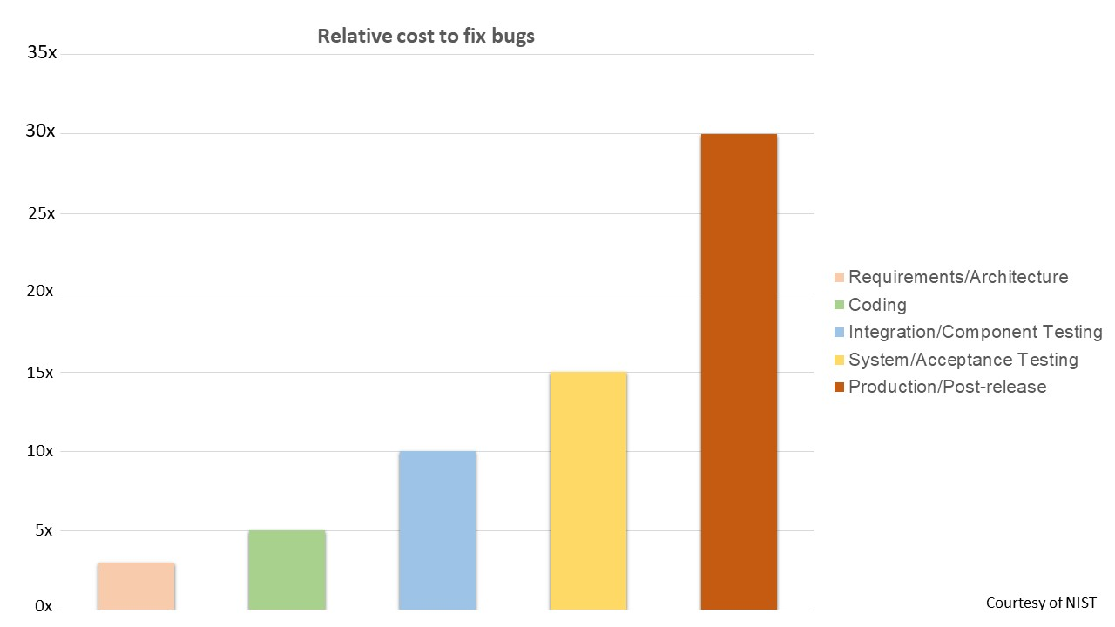
A bug is a piece of code that can and will break your code. The below image shows how much it costs to resolve bugs at various stages of a sample application. In the below image the x-axis represents the number of times the cost has been multiplied.

Slide 152
Benefits of following coding standards:
Efficient code
Less risk for project failure
Consistency will give code clarity
Since the code is consistent, bugs can be traced easily
Cost-effective, finding and resolving bugs after release is a costly process
Next, we will see what code quality is and the different tools to measure code quality.

Slide 153
As an application developer, we will be writing hundreds of lines of code in hundreds of files. Quality of your code defines how safe, secure, and efficient your application is. Hence the quality of the code written should be given as much importance as that of the most important feature of your application.
Code quality is a measure of how good or bad your code is. It is not a fixed value/standard, it will differ for different teams as different applications have different requirements. So a team has to define its custom standard or requirement for how good their code should be. They should also ensure that all the team members adhere to these standards strictly so that the final product is of the highest quality.
There are multiple traits one should find in the code to achieve the highest quality. Here are a few key traits that every good code should have.
Reliable: The code should be highly reliable, this is the measure of how long an application runs without failure.
Maintainable​​​​​​: It refers to how easy it is to maintain an application.
Testability: It refers to how easy it is to test individual components of any application.
There are multiple tools available in the market to measure code quality like:
PMD
Checkstyle
FindBugs
SonarQube

Slide 154
SonarQube is a server where we can host our projects and run analysis, it internally uses all the above-mentioned tools to detect issues and generate reports on the code quality. This will be seen in future courses.
SonarLint is a plugin/extension that allows developers to connect to the SonarQube server and run the analysis.
SonarLint is an extension/plugin that can be installed on an IDE ( Integrated Development Environment ) like Eclipse or Visual Studio Code to check for code quality on-the-fly. It scans the code being written for violations and suggests solutions to the developer dynamically like a spell checker. Since the code being written is checked on-the-fly, the productivity of the developer is increased many-fold.
Since it is installed as a plugin/extension, all the rules will be available offline, the developer need not be connected to a network while he/she is writing code. If a team of developers has a very specific requirement for its application, the developers can create a custom ruleset on the SonarQube server to which all other team members can connect with using the SonarLint plugin and follow the custom rules instead of the default rules. This ensures that the code is uniform throughout the application which will be beneficial in maintaining the application.

Slide 155
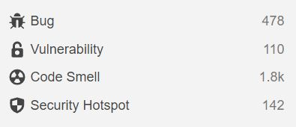
Here are some benefits of using SonarLint,
Rules are stored offline, hence internet connectivity is not required.
On-the-fly analysis ensures better code and increased productivity.
It can be customized to ignore unwanted files.
Rules can be customized to match the requirements of the projects specifically.
SonarLint has categorized the different violations a developer will/can do into different types, here are a few.

Slide 156
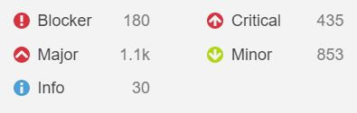
Bug: It is a part of the code that will break the execution of the application abruptly.
Vulnerability: It is a part of the code prone to external attacks leading to loss of critical information.
Code Smell: It is a part of the code written in an unnecessarily complicated manner leading to maintenance issues in the future.
Security Hotspot: Similar to a vulnerability, this may or may not lead to loss of user information, It is up to the developer to either fix this immediately or later on.
Violations are also categorized based on their severity to the application execution.

Slide 157
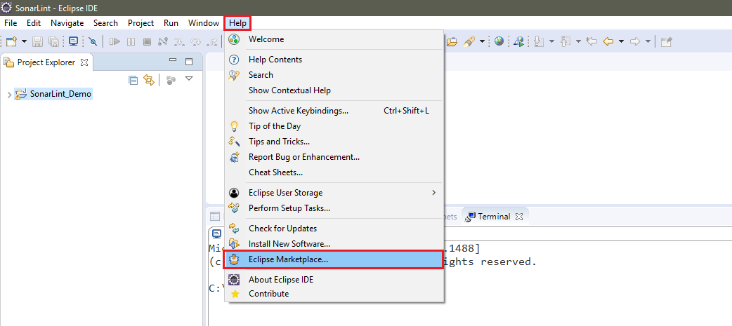
Steps to install SonarLint in Eclipse IDE.
Step 1: Launch the IDE and click on Help > Eclipse Marketplace

Slide 158
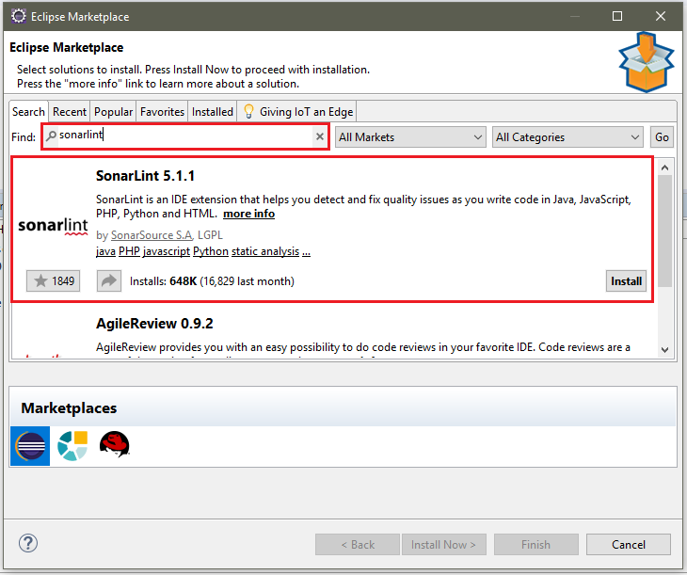
Step 2: In the pop-up window, Search for SonarLint and click on Install on the search result.

Slide 159
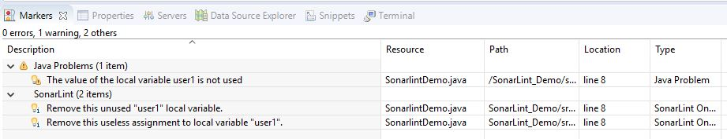
Note: The version of SonarLint is 5.1.1 during the installation. When you try to install it in your eclipse, the version might change.
Once the extension is installed, agree to the terms and conditions on the next page and click on finish. Restart eclipse(if not prompted) to enable the extension.
We are going to check for code quality using SonarLint
Once eclipse restarts, SonarLint will start scanning (by default) the files open in your workspace and list out all the violations/issues in the markers view as shown below.

Slide 160
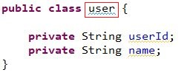
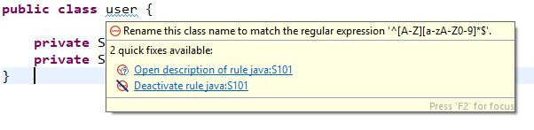
Since, SonarLint checks for issues on-the-fly, it will dynamically provide feedback on what you're coding. SonarLint will highlight the issue and provide information on what is wrong.
For example, the user class as defined below is violating the class naming convention.
On hovering over the violation being highlighted by SonarLint, we get the below screen,

Slide 161
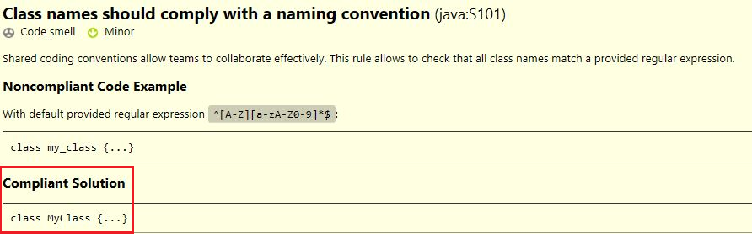
Click on the Open description link to see more detailed information on the rule. This description will include the reason as to why the usage is considered incorrect as well as a better and more compliant alternative that can be considered.
Click on Deactivate Rule, if a rule should be ignored for the rest of the code.

Slide 162
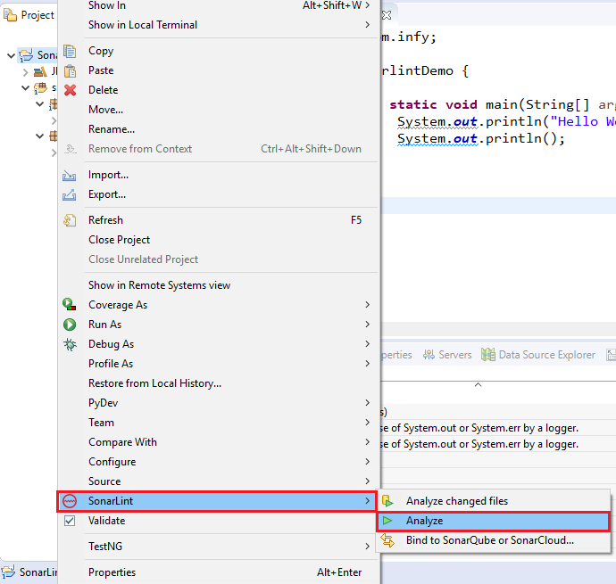
To manually check for code quality, Right Click on the project and click on SonarLint > Analyze

Slide 163
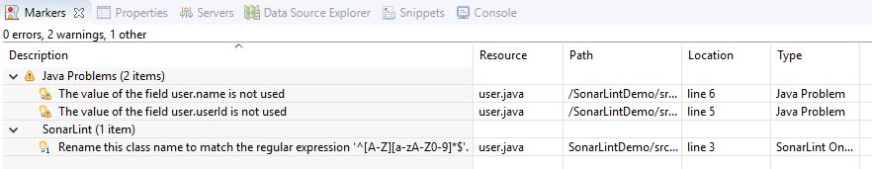
A new SonarLint Report view will be displayed as shown below. Click on the description to view detailed information on the rule.
Till now, we have displayed the data of our Java projects in the console of the Eclipse IDE using the System.out.* statements. But according to coding practices, this is a major violation.
What are these statements and why are they considered as major violations?
System.out.* statements are usually used when the developer wants to log some information related to the application on the console. But it is considered bad practice since the information logged by the application and the server the application is running on will log on the same console and it will become highly impossible to separate between the two.

Slide 164
Here are a few other reasons why a good developer should not use System.out statements in their code.
If the application/server stops, the information logged on the console is lost.
The developer should be able to access the logged information whenever required, hence the use of a separate log file is recommended.
The level of information being logged cannot be set when using System.out. So there is no difference between genuine information and an error message being logged.
There is no fixed format for the information being logged, so it is not easy for newer developers to understand what is being logged.
In this course, we will be using console-based applications for demos and assessments that require the developers to log certain data to the console, unlike an enterprise application that runs on a server. The data being logged is an indication for success or error status of the application. Hence System.out statements will be used in a limited capacity.
If a developer has a requirement to log information from an enterprise application, it is recommended to use frameworks specifically designed to overcome the issues of the System.out statements like Log4j2, Apache Commons Logging, SLF4J, etc.

Slide 165
Assignment 1
Problem Statement:
Quadratic equation is an equation with degree 2 in the form ax² +bx + c = 0, where a, b, c are the coefficients. Write a program to solve a quadratic equation.
Your output will be decided based on the value of the discriminant (which is b² -4*a*c),
If the discriminant value is 0, then both the roots will be equal. Print the value of the root obtained.
If the discriminant is greater than 0, then both of the roots are real and distinct. Print both the values.
If the discriminant is less than 0, then the equation will have no real roots. Print a message which conveys that the roots are not not real.

Slide 166
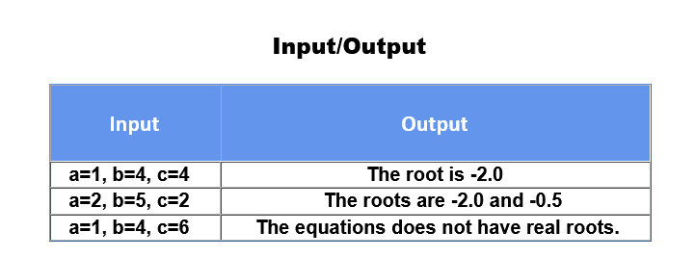
Sample I/O table:
Please refer the given table for sample input values and its corresponding output.
Note: Check the project using SonarLint to maintain the coding standards. Ignore the violations which occur due to "System.out" statements.

Slide 167
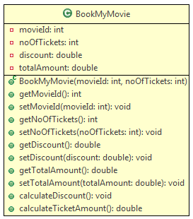
Assignment 2
BookMyMovie is an online website, through which the required number of tickets can be booked for a particular show. A maximum number of 15 tickets can be issued per booking. Implement the class BookMyMovie as per the class diagram given below:

Slide 168
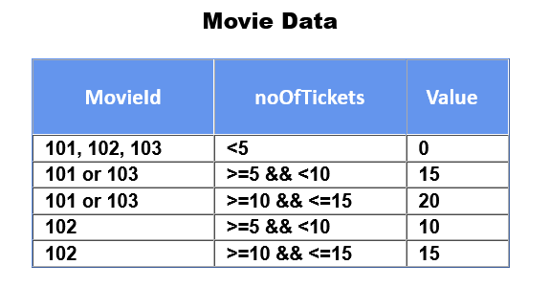
Method Description:
BookMyMovie(int movieId, int noOfTickets): This constructor is used to initialize the instance variables with user provided values.
calculateDiscount(): This method is used to set the discount percentage for a particular booking based on the noOfTickets issued and the movieId.
The condition for calculating the discount is given below:

Slide 169
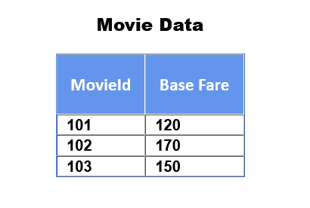
Note: In this above table, Value column stands for the discount percentage.
calculateTicketAmount(): This method is used to calculate the ticket amount after deducting the discount amount. It should call the method calculateDiscount() which sets the discount percentage. Then the totalAmount should be calculated using the formula given below:
totalAmount = baseFare * noOfTickets – (baseFare * noOftickets * (discount/100))
The baseFare for a given movieId is given below:

Slide 170
Once you implement the above class,
Create a Tester class.
Create objects of BookMyMovie class with the sample inputs given below.
Invoke the calculateTicketAmount() for each of the object and verify with the sample output provided.
Sample I/O:
Input (For BookMyMovie object 1):
movieId = 101
noOfTickets = 5
Output (For BookMyMovie object 1): Total amount for booking: 510.0
Input (For BookMyMovie object 2):
movieId = 102
noOfTickets = 4
Output (For BookMyMovie object 2): Total amount for booking: 680.0
Input (For BookMyMovie object 3):
movieId = 103
noOfTickets = 8
Output (For BookMyMovie object3): Total amount for booking: 1020.0

Slide 171
For any invalid movieId, the output should be,
Sorry! Invalid Movie ID!
Please check the Movie ID and enter once again.
Note: Check the project using SonarLint to maintain the coding standards. Ignore the violations which occur due to "System.out" statements.

Slide 172
Working with Regular Expression
A Regular Expression or Regex is a special sequence of characters that help in matching or finding other strings or set of strings, using a specialized syntax. Regex are used in searching, editing and manipulating the text.
The Regex API (java.util.regex) provides the necessary classes and interfaces for working with regular expressions. String class uses this API to support regex in its following methods: matches(), split(), replaceFirst(), and replaceAll(). Let us concentrate on the methods matches() and split() for now.
matches(): This method takes a regex as an argument and matches a given string with the specified regex pattern. This method returns a Boolean value for the comparison done.

Slide 173
//Creating a Pattern through Regular Expression
String regex = "Hello";
//String to be compared with RegEx
String input = "Hello";
//Pattern Matching done using matches() method
System.out.println(input.matches(regex));
//Pattern Matching done using Pattern.matches() method
System.out.println(Pattern.matches(regex, input));
/**
* Output: true, true
*/
It is interesting to note that, input.matches(regex) yields the same result as Pattern.matches(regex, input).(Note: Pattern is one of the classes provided by the Regex API)

Slide 174
split(): This method splits a given string into an array of string on the basis of regular expression mentioned in the argument of the method.
//Sample String
String chainedString = "Lets-break-this-chain-and-be-free-!";
//Creating Regex for splitting the String
String regex = "-";
//Splitting the String using split() method
//split()divides the String and stores them in a Array of String
String[] freeString = chained string.split(regex);
/**
* freeString = ("Lets", "break", "this", "chain", "and", "be", "free", "!")
*/
Now let's dive deeper and understand how to write Regular Expressions.

Slide 175
While working with strings, we must have wondered if there was an easier way to validate them. What if we could specify a required pattern directly instead of checking things character by character? What if we could provide a general pattern to search for instead of repeatedly looking for specific variations? And to make this possible, Java supports Regular Expressions.
Now the question arises: "How can we write such 'generalized' regular expressions?"
And before we go searching for the answers, let us see what a general regular expression looks like:
//Regular Expression for Name Validation:
String nameRegex = "([A-Za-z ]+)";
//Regular Expression for Email Id Validation:
String emailIdRegex = "([A-Za-z0-9-_]+)[@]([a-z]+)[.](com|in)";

Slide 176
To write a generalized regular expression, we require the help of the following:
Literals: They are the literal characters that have a literal meaning.
String literalRegex = "Hello"; //The string must be exactly "Hello" to match this Regex pattern
Meta Characters: They are reserved special characters/symbols which have special meaning in the Regex.
String metaRegex = "([A-Za-z0-9]+)" //The symbols and special characters have specific usages
Quantifiers: They are a type of metacharacters that specify the frequency of occurence of a character or group.
String metaRegex = "([A-Za-z0-9]+)" //The symbols "+" is a type of quantifier

Slide 177
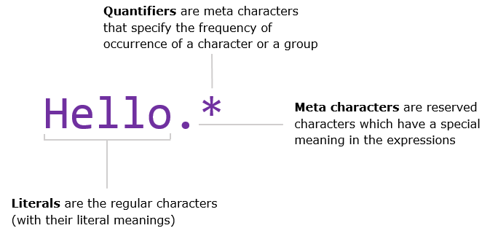
Now lets take a closer look at the different types of meta characters and quantifiers up next.

Slide 178
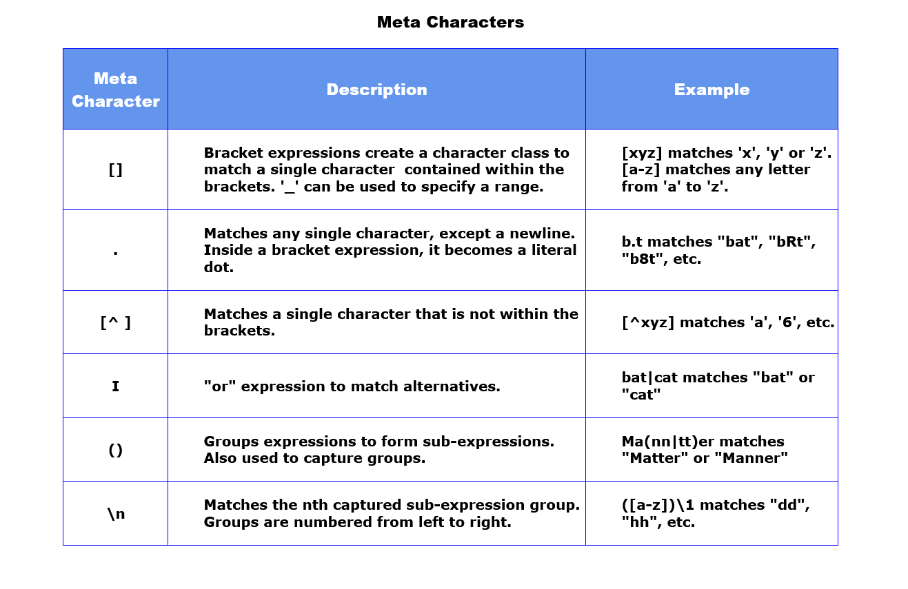
Let's take a look at the different metacharacters.

Slide 179
Note:
If meta characters are needed to be used as literals, they have to be escaped with a double backslash.
To refer to captured groups in the replacement methods, $<group no.> is used. E.g. str.replaceAll(regex, "$1");
Next, let us look at quantifiers.

Slide 180
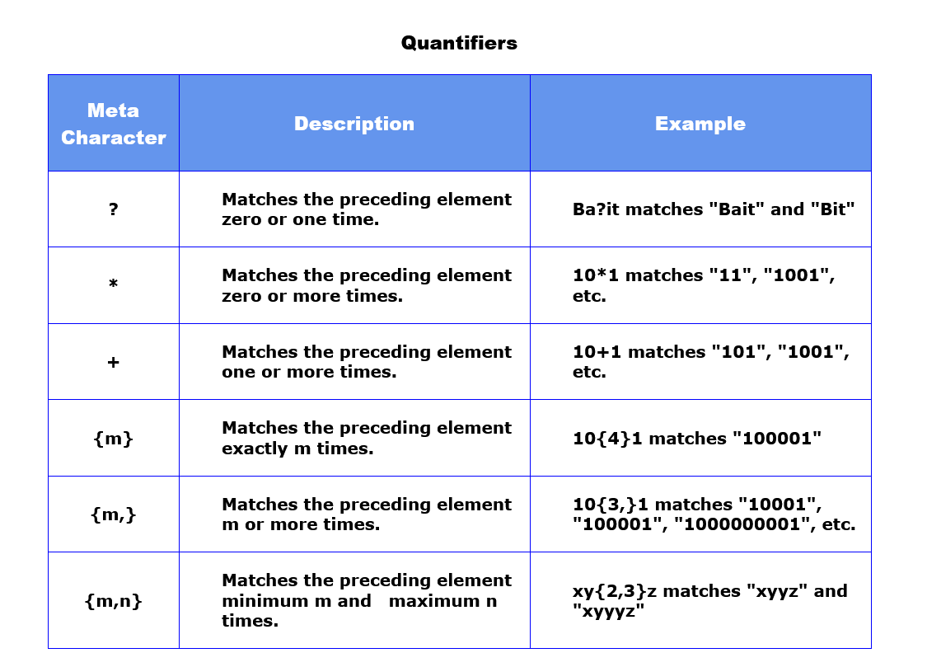
Let's take a look at the different quantifiers.

Slide 181

Now that we have seen different metacharacters and quantifiers, let's see some predefined classes used in Regex. These "predefined classes" can be used as alternatives to standard Regex written using only meta characters and literals.
Note:
"\w" is a meta character. But in Java, '\' is an escape character. Hence, we have to escape it using another backslash. E.g. "[\\w]+"
Now, let us see how you can write a regular expression.

Slide 182
Let's now see how to approach a pattern matching problem using the Regular Expression method. But before we proceed, it must be noted and understood that there can be multiple solutions to a problem.
Let's consider a situation where we have to validate a Courier Consignment Tracking Number. The required format/pattern for the tracking number is given as:
Format of Courier Consignment Tracking Number:
<<2_Uppercase_Characters>>-<<9_digits>>:<<2_Uppercase_Characters>>
Example: "EK-860619645:IN"
Let us observe all the character sets the string is containing. This pattern has only Uppercase Alphabets, Digits and Two Special Characters '-' and ':'. Next, let us find the frequency of occurrences for the character classes. With that, let's break the pattern into smaller sub-patterns:

Slide 183
The first sub-pattern is having two uppercase characters followed by "-" character. So, the Regex for this sub-pattern can be written as:
String firstSubRegex = "[A-Z]{2}[-]";
The second sub-pattern has 9 digits followed by ":" character. So, the Regex for this sub-pattern can be written as:
//First Alternative:
String secondSubRegex = "[0-9]{9}[:]";
//Another Alternative:
String secondSubRegex = "[\\d]{9}[:]";
The last sub-pattern is having only two uppercase characters again. So, the Regex for this sub-pattern can be written as:
String thirdSubRegex = "[A-Z]{2}"

Slide 184
Hence, the overall matching pattern can be written as:
//Concatenation of all three Sub-Regex:
String finalRegexPatternConcat = firstSubRegex + secondSubRegex + thirdSubRegex;
//Alternatively the single Regex:
String finalRegexPatternComplete = "([A-Z]{2}[-])([\\d]{9}[:])([A-Z]{2})";
Now, let us look at some more examples on Regular Expressions.

Slide 185
Now let us conclude Regular Expressions by looking into following situational examples:
Requirement: To search the pattern "App" in the given string "Application".
String searchStr = "Application";
String regexStr = "App.*";
System.out.println(searchStr.matches(regexStr)); //Output: true
Requirement: To search the pattern having two characters in between A and l in the given string "A%(lication"
String searchStr = "A%(lication";
String regexStr = "A..lication";
System.out.println(searchStr.matches(regexStr)); //Output: true

Slide 186
Requirement: To search for a digit between M and t in the given string "M4thematics".
String searchStr = "M4thematics";
String regexStr = "M\\dt.*";
System.out.println(searchStr.matches(regexStr)); //Output: true
Requirement: To search for a number between 4 and 8 in between X and Y in the given string.
String searchStr = "X9Y";
String regexStr = "X[4-8]Y";
System.out.println(searchStr.matches(regexStr)); //Output: false

Slide 187
Requirement: To search for the pattern "Hell" or "Fell" in the given string "Fellow".
String searchStr = "Fellow";
String regexStr = "(Hell|Fell).*";
System.out.println(searchStr.matches(regexStr)); //Output: true
Requirement: To check for the space after "Air" in the given string "Air line".
String searchStr = "Air line";
String regexStr = "Air\\s.*";
System.out.println(searchStr.matches(regexStr)); //Output: true

Slide 188
Requirement: To check if a number is found 0 or n times after X in the given string.
String searchStr = "X4756Y";
String regexStr = "X\\d*Y";
System.out.println(searchStr.matches(regexStr)); //Output: true
Requirement: To check if a number is found 1 or n times after M in the given string.
String searchStr = "M4N";
String regexStr = "M\\d+N";
System.out.println(searchStr.matches(regexStr)); //Output: true

Slide 189
Requirement: To check if a number is found 0 or 1 times after A in the given string.
String searchStr = "M2N";
String regexStr = "M\\d?N";
System.out.println(searchStr.matches(regexStr)); //Output: true
Requirement: To check if 3 digits are present after A in the given string.
String searchStr = "M42N";
String regexStr = "M\\d{3}N";
System.out.println(searchStr.matches(regexStr)); //Output: false
Now, let's look further into grouping of Regular Expressions.

Slide 190
Grouping of a Regular Expression is done to divide a complete pattern into smaller groups of the pattern. This is done by using the parenthesis "()" brackets. Let us look at the various situations where grouping is necessary:
Grouping is necessary to group a combination of letters or words together:
//Regex to search between two alternatives: "Scanner" or "Scammer":
String regex = "Sca(nn|mm)er";
String demoStr = "Scammer";
System.out.println(demoStr.matches(regex));
//Regex to search for a particular word in a String
String regex = ".*(dog).*";
String demoStr = "Bowser was my dog."
System.out.println(demoStr.matches(regex));

Slide 191
Grouping is necessary to divide a bigger pattern into smaller patterns. Let us take a previous example to observe this better. We had the format for Courier Consignment Tracking Number as "<<2_Uppercase_Characters>>-<<9_digits>>:<<2_Uppercase_Characters>>".
And this pattern could be divided into the following three parts: Regex Sub-Pattern 1: The first sub-pattern is having two uppercase characters followed by "-" character - "[A-Z]{2}[-]“
Regex Sub-Pattern 2: The second sub-pattern has 9 digits followed by ":" character - "[\\d]{9}[:]"
Regex Sub-Pattern 3: The last sub-pattern is having only two uppercase characters again - "[A-Z]{2}"
//Grouping of Regex done according to Sub-patterns using "()":
String regex = "([A-Z]{2}[-])([\\d]{9}[:])([A-Z]{2})";

Slide 192
Grouping is necessary for validating repeating/non-repeating sequences. In order to do so, we also use Back Referencing along with Grouping:
//Regex to search for repeating sequence in the String:
String passCodeRegex = ".*(\\d)\\1+.*";
String passCodeStr = "2455254";
System.out.println(passCodeStr.matches(passCodeRegex));
Here, "\\1" after "(\\d)" in the regular expression is called a backreference. It helps in checking the group mentioned in the regex is repeating or not.
//Regex having three groups being Back-Referenced
//The three groups must repeat after the ":" symbol in the String to match the pattern.
String repeatRegex = "([A-Za-z0-9]+) (\\d+) ([A-Z]+) [:] \\1 \\2 \\3";
String repeatStr = "Tom123 9090 JERRY : Tom123 9090 JERRY";
In the above example, "\\1" refers to the first group "([A-Za-z0-9])", "\\2" refers to "(\\d+)" and "\\3" refers to "([A-Z]+)". And so, the regex expects the string to have all the three groups repeat itself whenever the back referencing is done.

Slide 193
Application of Matches() - Tryout
Problem Statement :
The regex API (java.util.regex) provides classes and interfaces to work with regular expressions. The String class uses this API to support regex method matches().
Let’s see code in the next slide..

Slide 194
class RegexDemo {
public static void main(String args[]) {
String str = new String("We are going to learn Regular Expression in Java");
//Declaring Regular Expressions For Comparisons
String regex1 = "[A-Z].*";
String regex2 = ".*to.*";
/**
* Different Uses of matches() method:
* Note: matches() returns Boolean value (True/False) as result.
*/
//1. Checking the given String starts with an Uppercase Letter:
System.out.println("Does the string start with an Uppercase Letter? : "+str.matches(regex1));
//2. Checking the given String contains a particular Substring in it:
System.out.println("Does the string contain the word 'to'? : " +str.matches(regex2));
String str2 = "Thomas34";
//Declaring the pattern as a Regular Expression:
/**
* The Required Pattern is:
* 1. First letter of String should be Uppercase [A-Z]
* 2. Atleast one letter in lowercase ([a-z]+)
* 3. should end with any two digit number \\d{2}
*/
String regex3="[A-Z]([a-z]+)\\d{2}";
//3. Checking the given String follows a given Pattern:
System.out.println("Does ("+str2+") match with required pattern ? : "+str2.matches(regex3));
}
}

Slide 195
Writing and Comparing Regex - Tryout
Problem Statement :
Leeroy wants to validate the personal details which should be in the following format:
Name: It can only contain characters and spaces.
Email Id: <firstname>.<lastname>@<any>.<com/in>
User Id: <firstname>#<any 2 digits><lastname>
Account Serial Id: WoW-<any 7 alphabetic code><any 5 digits><Same 7 alphabetic code>_<any 5 alphanumeric code>
On successful execution of code it will return the result as "true" or "false", let's see how we can achieve this using Regex.

Slide 196
class PersonalDetailValidatorDemo {
public static void main(String args[]) {
//Personal Details:
String name = "Leeroy Jenkins";
String emailId = "leeroy.jenkins@wow.com";
String userId = "leeroy#78jenkins";
String accSerialId = "WoW-ABilOpZ00523ABilOpZ_a00Z9";
//Splitting Full Name Into an Array:
String[] nameSplit = name.toLowerCase().split(" ");
/**
* Regular Expression for each field according to the requirements:
*/
//Regular Expression for Name Validation:
String nameRegex = "([A-Za-z ]+)";
//Regular Expression for Email Id Validation:
String emailIdRegex = nameSplit[0]+"."+nameSplit[1]+"[@]([a-z]+)[.](com|in)";
//Regular Expression for User Id Validation:
String userIdRegex = nameSplit[0]+"[#]([0-9]{2})"+nameSplit[1];
//Regular Expression for Account Serial Id Validation:
String accSerialRegex = "(WoW)[-]([A-Za-z]{7})(\\d{5})\\2[_]([A-Za-z0-9]{5})";

Slide 197
/**
* Matching the Personal Details with the pattern specified:
*/
//Validating Name:
System.out.println("Does the name ("+name+") match the pattern? : "+name.matches(nameRegex));
//Validating Email Id:
System.out.println("Does the email ID ("+emailId+") match the pattern? : "+emailId.matches(emailIdRegex));
//Validating User Id:
System.out.println("Does the user ID ("+userId+") match the pattern? : "+userId.matches(userIdRegex));
//Validating Account Serial Id:
System.out.println("Does the account serial ID ("+accSerialId+") match the pattern? : "+accSerialId.matches(accSerialRegex));
}
}

Slide 198

Regular Expression - Exercise
Problem Statement:
Write a program to validate the given web address is a valid one or not according to the following guidelines:
It should start with either http or https
It should be followed by "://"
It may have "www."
The web address should be alphanumeric
After a "." the domain name should be one among "com", "org", "net"
Create a class, WebAddressValidator, as shown below, to implement the logic.
WebAddressValidator:

Slide 199
Method Description:
isValidWebAddress(String webAddress): This method accepts the webAddress entered by the user and validates it.
To test the above functionality, make a Tester class.
Sample:
Input (Valid): "http://www.google.com"
Output: "You have entered a valid web address"
Input (Invalid): "http.www.google.au"
Output: "You have entered an invalid web address"
Note: Check the project using SonarLint to maintain the coding standards. Ignore the violations which occur due to "System.out" statements.

Slide 200
class WebAddressValidator{
public boolean isValidWebAddress(String webAddress){
//code here
return false;
}
}
class Tester{
public static void main (String[] args) {
//code here
}
}

Slide 201
LocalDate
LocalDate
LocalDate is an immutable class (present in java.time package) that represents a date with default format "yyyy-MM-dd" (year-month-day). We can access other date fields, such as day-of-year, day-of-week and week-of-year from this class . For example, the value "4th Jan 2007" can be stored in a LocalDate in the default format (2007-01-04).
This class does not store or represent a time or time-zone.
LocalDate Methods
This class consists of default methods such as minusDays, minusMonths, minusYears, now, plusDays etc which help us in various scenarios where date is concerned.
Now, we will see the implementation of some most used methods of LocalDate Class.

Slide 202
LocalDate today = LocalDate.now(); // now() returns the current date from system clock
System.out.println(today); // output will be today's date
LocalDate dateObj = LocalDate.of(1997, 8, 29); // of() returns the instance of LocalDate
//with specified arguements
System.out.println(dateObj); // output : 1997-08-29
Consider a scenario where we want to display the date (given above) i.e. 1997-08-29 in format of dd/MM/yy (i.e. 29/08/97). In that case what can we do ?
To solve this problem Java provides us with a different class which is used for parsing dates in different formats. This class is called as DateTimeFormatter (present in java.time package). Implementation of the same is given below.

Slide 203
LocalDate dateObj = LocalDate.of(1997, 8, 29);
DateTimeFormatter df = DateTimeFormatter.ofPattern("dd/MM/yy"); //ofPattern() creates a formatter using the specified pattern.
System.out.println(df.format(dateObj)); //output 29/08/97
LocalDate provides methods with which we can manipulate the date, for example plusYears() - which returns a copy of LocalDate with the specified number of years added, similarly minusDays(), minusWeeks(), etc.
LocalDate newDate = LocalDate.now();
newDate = newDate.plusDays(34);
System.out.println(newDate); // 2020-04-09
newDate = newDate.plusYears(45); // 2065-04-09
newDate = newDate.minusWeeks(87); // 2063-08-09

Slide 204
Now we will see some of the methods which will allow us to get the difference between two dates.
LocalDate today = LocalDate.now();
LocalDate newDateObj = today.minusWeeks(39);
System.out.println(ChronoUnit.DAYS.between(newDateObj,today)); //273
//between() calculates the amount of time between specified date objects
System.out.println(ChronoUnit.MONTHS.between(newDateObj,today)); //8
//compareTo() compares this date with specified date
System.out.println(newDateObj.compareTo(today)); //-1
Java8 provides us ChronoUnit which is an enum, it is standard set of date periods units. This set of units provide unit-based access to manipulate a date, time or date-time. In example given above we are calculating difference between two date objects in Days and Months.
Method description of some methods is given below:

Slide 205
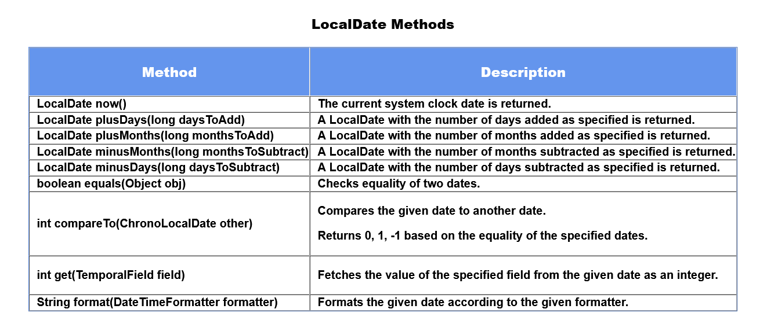

Slide 206
You will further explore about LocalDate class in tryout.
Now as you are well aware with Java LocalDate , there is similar class called as LocalTime which provides methods to manipulate time. We will discuss it in next module.

Slide 207
LocalDate - Tryout
Problem Statement :
Here are a few examples showing how LocalDate methods makes date operations easier with their methodslike plusDays(),plusWeeks(),plusMonths(),plusYears(),minusDays(),minusWeeks(),minusMonths,()minusYears(),isBefore(),isAfter(),getDayOfWeek() & getMonth(),format().
Do make changes to the code if you're feeling curious enough.

Slide 208
import java.time.LocalDate;
import java.time.Month;
import java.time.format.DateTimeFormatter;
import java.time.temporal.ChronoUnit;
class Tester {
public static void main(String[] args) {
// To print today's date which function should I use ?
//LocalDate provides the output in the form of YYYY-MM-DD
LocalDate today = LocalDate.now();
//Invoking the static now() will return the current date from the system clock
System.out.println(today);
/*
* To display any date in default format we use of() method.
* of() takes parameters as public static LocalDate of(int year,Month month,int dayOfMonth)(where Month is enum )
* Or public static LocalDate of(int year,int month,int dayOfMonth)
* This returns a LocalDate with the specified year, month and day-of-month
*/
System.out.println();
System.out.println("************"+"of()"+"************");
System.out.println("LocalDate.of(2018, 8, 29) :- "+LocalDate.of(2018, 8, 29));
System.out.println("LocalDate.of(2017,Month.APRIL, 29) :- "+LocalDate.of(2017,Month.APRIL, 29));
/*
To access the date information we have certain methods like getYear(),getMonth(),getDayOfMonth() etc.
*/

Slide 209
System.out.println();
System.out.println("***********DateTimeFormater***********");
LocalDate date = LocalDate.parse("13 Feb, 2020", DateTimeFormatter.ofPattern("dd MMM, yyyy"));
System.out.println(date.format(DateTimeFormatter.ofPattern("dd-MMM-yyyy")));
System.out.println("Input Format is 13 Feb, 2020 \nOutput Format :- "+date);
/*
.format() method formats the date according to user defined pattern.
*/
String dateString = date.format(DateTimeFormatter.ofPattern("dd/MMM/uuuu"));
System.out.println(dateString);
/*
The DateTimeFormatter class in Java is used for parsing dates in different formats.
ofPattern method will create a formatter based on the pattern given by the programmer.
For example, d MMM yyyy will format 2011-12-03 as '3 Dec 2011'.
*/
System.out.println();
System.out.println("************"+"Functions to access date information"+"************");
System.out.println("Today's Date :- "+LocalDate.now());
System.out.println("Month in Today's Date :- "+LocalDate.now().getMonth());
System.out.println("What is the current year going on .... ? :- "+LocalDate.now().getYear());
System.out.println("Which day is today ? :- "+LocalDate.now().getDayOfWeek());
/*
getDayOfWeek() & getMonth() :- returns an enum instead of int value.
To get int value, we can use getValue() methods
Try :- System.out.println("Month in Today's Date :- "+LocalDate.now().getMonth().getValue());
System.out.println("Which day is today ? :- "+LocalDate.now().getDayOfWeek().getValue());

Slide 210
*/
/*
Following are methods for localdate calculations
plusDays(),plusWeeks(),plusMonths(),plusYears(),minusDays(),minusWeeks(),minusMonths,()minusYears()
All of these methods take parameters having Long datatype
*/
System.out.println();
System.out.println("************"+"LocalDate Calculations"+"************");
System.out.println("Today's Date :- "+LocalDate.now());
System.out.println("Date after 7 days ? => "+LocalDate.now().plusDays(7));
System.out.println("Date after 7 months ? => "+LocalDate.now().plusMonths(7));
System.out.println("Date after 7 Years ? => "+LocalDate.now().plusYears(7));
System.out.println("Date after 7 weeks ? => "+LocalDate.now().plusWeeks(7));
System.out.println();
/*
Try :-
Find the date 20 days ago and 4 months ago and 40 years ago
*/
System.out.println();
System.out.println("************"+"Difference using ChronoUnit"+"************");
LocalDate dateObj = LocalDate.of(1997, Month.FEBRUARY, 15);
System.out.println("Difference Between dateObj and today's date in number of Years");
System.out.println(ChronoUnit.YEARS.between(dateObj, LocalDate.now()));
// Calculate the number of days between dateObj and today's date
/*
We can also modify the date using ChronoUnit
*/

Slide 211
System.out.println();
System.out.println("Modification of date using ChronoUnit :- ");
System.out.println("Today's date :- "+LocalDate.now());
System.out.println("Date After 5 days :- "+LocalDate.now().plus(5,ChronoUnit.DAYS));
//Try adding months and years in the current date.
System.out.println();
System.out.println("until() with ChronoUnit");
LocalDate todayObj = LocalDate.now();
LocalDate date1 = LocalDate.of(2014,5,25);
System.out.println("Difference between todayObj and date1(in terms of Number of Days) :- "+date1.until(todayObj,ChronoUnit.DAYS));
//calulcate the difference in terms of months and years
/*
To Compare two dates we also have compareTo() method
Method Signature of compareTo() :- int compareTo(chronoLocalDate date)
It returns the value 0 if the argument Date is equal to this Date.
It returns a value less than 0 if this Date is before the Date argument.
It returns a value greater than 0 if this Date is after the Date argument.
Try Comparing today's date with date1 using compareTo()
*/
System.out.println();
System.out.println("************"+"isAfter() and isBefore()"+"************");
LocalDate dateFirst = LocalDate.of(2018, 2,21);
LocalDate dateSecond = LocalDate.of(2018, 2,20);
System.out.println("dateFirst.isBefore(dateSecond) :- "+dateFirst.isBefore(dateSecond));
System.out.println("dateFirst.isAfter(dateSecond) :- "+dateFirst.isAfter(dateSecond));
}
}

Slide 212
LocalTime and LocalDateTime
LocalTime
LocalTime is a class that represents time with a default format of "hour-minute-second" (hh-mm-ss.zzz). It is immutable by nature. Time is represented to the precision of nanosecond. For example, the value "09:11:44.140" can be stored in a LocalTime in the default format.
LocalDate Class is present in java.time package.
LocalTime Methods
This class consists of default methods such as minusHours, minusMinutes, of, now, plusHours etc which help us in various scenarios where time is concerned.
Now we will see the implementation of some most used methods.

Slide 213
LocalTime currentTime = LocalTime.now();
System.out.println(currentTime); // will display current time eg. 15:44:44.932359900
LocalTime newTimeObj = LocalTime.of(9, 45, 59);
System.out.println(newTimeObj); //09:45:59
DateTimeFormatter df = DateTimeFormatter.ofPattern("h:mm:ss");
System.out.println(df.format(currentTime)); //will give output in specified format eg.3:44:44
As we have seen ChronoUnit and DateTimeFormatter in LocalDate, we will try methods related to those classes in tryout.
To access the fields (hour, minute, etc.) we use get method. Implementation of the same is given below.

Slide 214
LocalTime newTimeObj = LocalTime.of(9, 45, 59);
int hour = newTimeObj.getHour();
int second = newTimeObj.getSecond();
int minute = newTimeObj.getMinute();
System.out.println(hour+":"+second+":"+minute); //9:45:59
Rest of the methods we will learn in tryout.

Slide 215

Description of some methods, of the LocalTime class, is given below.

Slide 216
LocalDateTime
LocalDateTime is an immutable class that represents a date-time, with the default format as "yyyy-MM-dd-HH-mm-ss.zzz" year-month-day-hour-minute-second. Other date and time fields, such as day-of-year, day-of-week and week-of-year, can also be accessed.
Time is represented to nanosecond precision. For example, the value "2nd October 2007 at 13:45.30.123456789" can be stored in a LocalDateTime.
This class does not store or represent a date or time-zone.
LocalDateTime Class is present in java.time package with the method declaration as shown below:
LocalDateTime Methods
This class consists of default methods such as minusDays, minusMonths, minusYears, now, plusDays etc which help us in various scenarios where date is concerned.
We will see the implementation of some methods.

Slide 217
LocalDateTime currentDate = LocalDateTime.now();
System.out.println(currentDate); // output in default format eg. 2020-03-06T16:25:10.257251100
System.out.println(currentDate.getDayOfWeek()); // will give today's day eg. FRIDAY
If we want to display DateTime in specific format we use DateTimeFormatter and format method, as shown.
LocalDateTime currentDate = LocalDateTime.now();
System.out.println(currentDate);
DateTimeFormatter df = DateTimeFormatter.ofPattern("dd/MM/yyyy/ hh:mm:ss a"); // a is used to display 12 hr clock
System.out.println(df.format(currentDate)); //output in specified format eg. 06/03/2020/ 04:32:35 PM

Slide 218
Now, consider a situation where it is required to display the day, can we do it using DateTimeFormatter class?
DateTimeFormatter df = DateTimeFormatter.ofPattern("eeee dd/MM/yyyy/ hh:mm:ss a");
System.out.println(df.format(currentDate));
//output :- Friday 06/03/2020/ 04:50:54 PM
DateTimeFormatter dfNew = DateTimeFormatter.ofPattern("eee dd/MM/yyyy/ hh:mm:ss a");
System.out.println(df.format(currentDate));
//output :- Fri 06/03/2020/ 04:50:54 PM
As we can see we used modified the pattern with eeee or eee which displays the day of the date.
"eee” – Displays starting three letters of Day of the week such as “Mon”, “Tue”, etc. “eeee” – Displays the full name of the Day of the week such as “Monday”, “Tuesday” etc.
Can we try "ee" ?
Let's find it's solution in tryout.

Slide 219
LocalTime - Tryout
Problem Statement:
Here are few examples which shows how LocalTime makes operations easy. Trainees are supposed to solve the problem given at the end of the tryout.
import java.time.LocalTime;
import java.time.temporal.ChronoUnit;
class Tester {
public static void main(String[] args) {
LocalTime current = LocalTime.now();
System.out.println("Current Time :- "+current);
System.out.println();
System.out.println("************"+"of()"+"************");
System.out.println("LocalTime.of(2, 55, 29) :- "+LocalTime.of(2, 55, 29));
/*
* of(int hour, int minute, int second, int nanoOfSecond)
(mandatory) hour => the hour-of-day to represent, from 0 to 23
(mandatory) minute => the minute-of-hour to represent, from 0 to 59
(optional) second => the second-of-minute to represent, from 0 to 59
(optional) nanoOfSecond => the nano-of-second to represent, from 0 to 999,999,999

Slide 220
*/
System.out.println();
System.out.println("************"+"Functions to access date information"+"************");
System.out.println("What is the current hour going on .... ? :- "+LocalTime.now().getHour());
/*
Try with different scenarios with functions such as getMinute(),getNano() etc.
*/
System.out.println();
System.out.println("************"+"LocalTime Calculations"+"************");
System.out.println("Time after 20 hours ? => "+LocalTime.now().plusHours(20));
/*
Try with different scenarios with functions such as plusMinutes(),plusSeconds() etc.
*/
System.out.println();
System.out.println("************"+"Difference using ChrnoUnit"+"************");
LocalTime timeObj = LocalTime.of(23,20);
System.out.println("Difference Between current time and timeObj :- "+ChronoUnit.HOURS.between( LocalTime.now(),timeObj));

Slide 221
/*
Exercise :-
Thomas has to board train departing at 8:00 PM, You have to check whether he will be able to board or not.
It takes him 2.5 hrs to reach the station and further 15 mins to reach the platform.
Before what time should he leave his house in order to board the train ?
(Hint :- You can use isAfter() and isBefore() methods, take reference from LocalDate tryout)
*/
}
}

Slide 222
Date Time API - Exercise 1
Problem Statement Create an age calculator that determines the age from a given date, up to the day precision.
Use the LocalDate class.
Sample:
Input:
"2/11/1991"
Output:
Date: 02-11-1991
You are 22 years, 7 months and 11 days old.
Note: Check the project using SonarLint to maintain the coding standards. Ignore the violations which occur due to "System.out" statements.

Slide 223
import java.time.LocalDate;
import java.time.temporal.ChronoUnit;
class Tester{
public static void main(String[] args) {
LocalDate today = LocalDate.now();
//code here
}
}

Slide 224
Static Keyword
Ford, a car manufacturing company, wants to keep a count of the cars manufactured. The class below creates a car based on the model and color and also keeps their count.
class Ford {
private String modelNo;
private String color;
private int noOfCars; // For counting cars
public Ford(String modelNo, String color) {
this.modelNo = modelNo;
this.color = color;
this.noOfCars++; // Incrementing the count
}
}

Slide 225
Each time the company receives an order for a new car, we expect the value of noOfCars to be incremented.
But it is not working!! Can you figure out why?
… because for every object of the class, a new copy of all the instance variables and methods are created.
This calls the need for a kind of variable that can be shared and manipulated by all the instances of a class. Java's solution to this is the static keyword.
Static keyword is used to make a member belong to a class, and not to any of its individual objects. Only one copy of the member is maintained across all the instances. We can have static variables, methods, and blocks.
The static variables are class level variables that are used to keep a value across all the instances of a class. They are initialized when the class gets loaded.

Slide 226
The class Ford can now be modified to meet the requirements:
class Ford {
private String modelNo;
private String color;
private static int noOfCars; // Creates a class variable
public Ford(String modelNo, String color) {
this.modelNo = modelNo;
this.color = color;
noOfCars++; // For every object created, the value of the same variable gets incremented
}
}
Now let's see how static methods and static blocks can be useful…

Slide 227
Static methods are class level methods. They can be used without any instance of the class, and are invoked using the class name. They can be called using a reference of the class as well.
Let's say, instead of creating an object of Ford ourselves, we want to place an order for it and have Ford make it for us. We just want to specify the model and color.
Ford's method to do this has to be static as it needs to be common for all.
public static Ford orderCar(String model, String color) {
Ford car = new Ford(model, color);
return car;
}
The method call will look something like this:
public static void main(String args[]) {
Ford myMustang = Ford.orderCar("Mustang", "Red");
System.out.println("Thanks for ordering a Ford ...Drive safe!");
}

Slide 228
What is a Static Block?
Java supports a special block, called static block which gets executed when the class is loaded in the JVM. A static block is used for initializing static variables.
The code in the static block will get executed, once either of the below condition satisfies, when
The object is created
The first time a static member of that class is accessed.
A Class can have multiple static blocks, which will execute in the same sequence in which they have been written.
Why do we need Static Block?
If a class has static members which require complex initialization, in that case, the static block is the solution.
Rules of Static Block
Static block cannot return a value.
Static blocks get executed before constructors.
Static block is used to initialize static variables only; it gives compilation error if we try to initialize non-static variables.
Keywords like this and super cannot be used inside the static block.

Slide 229
Let's take an example. Suppose we need to automatically generate the driver IDs in the Driver class, starting from some initial value:
private static int counter;
static {
int randomNumber = 30;
counter = (int) Math.pow(randomNumber, 3);
}
This static counter variable can now be used to initialize the driver IDs of the drivers:
public Driver() {
this.driverId = counter++;
}
Static block cannot be called explicitly.

Slide 230
Now have a look at this,
class Ford {
private String modelNo;
private String color;
private String bookingId;
private static int noOfCars;
public static void generateBookingId() {
this.bookingId = "F" + noOfCars; // Compilation Error! Why?
}
}
The static method doesn't belong to any object, so it does not know a member of which object we are trying to access. Trying to do so will result in a compilation error.
A static context, i.e. static blocks and static methods, cannot access non-static (instance) members directly.
However, non-static methods can access static members.

Slide 231
Static Tryout - 1
Problem Statement
The code given below illustrates the usage of static keyword, method, and block to display student details. In class StudentDetails, all the students share the same department name and each student has a unique rollCount. Modify the code according to the comments given at the end of the tryout.
class StudentDetails{
String name;
//static variable
static String department;
static int rollCount=0;
//static block is used to initialize static variable
static{
System.out.println("Inside Static Block");
department="CS";
}
//static method to change the value of static variable
static void change(){
rollCount++;
}
//constructor to initialize the variable
StudentDetails(String studentName){
change();
name = studentName;
}

Slide 232
//method to display values
void display(){
System.out.println(rollCount+" "+name+" "+department);
}
}
//Test class to create and display the values of object
class Student{
public static void main(String args[]){
StudentDetails student1 = new StudentDetails("Tom");
student1.display();
StudentDetails student2 = new StudentDetails("Chris");
student2.display();
StudentDetails student3 = new StudentDetails("Morris");
student3.display();
//We can change the value of static variable department as shown below
//Display student4 object with ECE department
//Uncomment the code given below to perform the task
/*StudentDetails student4 = new StudentDetails("Cherry");
StudentDetails.department="ECE";
student4.display();*/
}
}

Slide 233
Static Tryout - 2
Problem Statement
This tryout demonstrates the usage of static variables, static methods and static blocks. It also shows automatic bookId generation using the concept of static variables and static blocks.
class Book{
String bookId;
String bookName;
//This is a Static variable which stores the total noOfBooks that InfyLibrary has.
private static Integer noOfBooks=1000;
//Whenever a new Book object is created, a bookId is generated and the noOfBooks increases by 1.
public Book(String bookName) {
noOfBooks++;
this.bookId="B"+noOfBooks;
this.bookName=bookName;
}
//This static method is used to return the total noOfBooks that the library has.
public static Integer getNoOfBooks() {
return noOfBooks;
}
}
class InfyLibraryApplication {
public static void main(String[] args) {
System.out.println("Total number of books in the library currently are: "+Book.getNoOfBooks());
Book b1=new Book("The Alchemist");
System.out.println("BookName: "+b1.bookName+" ; bookId: "+b1.bookId);
Book b2=new Book("The Hunger Games");
System.out.println("BookName: "+b2.bookName+" ; bookId: "+b2.bookId);
System.out.println("Total number of books in the library currently are: "+Book.getNoOfBooks());
}
}

Slide 234
Static - Exercise 1
Problem Statement
The code given below consists of the class Car and Tester, both having static methods. Some part of the code is missing, you are supposed to code the remaining part to get the output as given below
Output:
Displaying Car details Number of cars created: 3 Color of the cars: Color of the car : Red Color of the car : Green Color of the car : Blue
Note: Check the project using SonarLint to maintain the coding standards. Ignore the violations which occur due to "System.out" statements.

Slide 235
class Car {
private String color;
private static int numberOfCars = 0; //static variable
public Car(String color) {
// code here
}
public String getColor() { //static method
return this.color;
}
public static int getNumberOfCars() {
return numberOfCars;
}
public void displayColor() {
System.out.println("Color of the car : "+this.color);
}
}
class Tester {
public static void displayCar() {
System.out.println("Displaying Car details");
}
public static void main(String[] args) {
Car c1 = new Car("Red");
Car c2 = new Car("Green");
Car c3 = new Car("Blue");
/*
write code here to display the color
*/
}
}

Slide 236
Overloading
When we need different implementations of the same behavior depending upon the context, we go for method overloading.
Method overloading lets you have more than one method with the same name in a class. The methods accept parameters differing in their data types, the number of parameters, or their order.
Let's say we want to search for cars in a car store based on certain criteria, like manufacturer, color, etc. We can have overloaded methods to search for cars.

Slide 237
class CarStore {
public void searchCar(String manufacturer) {
// finds cars from the desired manufacturer
}
public void searchCar(float topSpeed) {
// finds cars having the desired top speed
}
public void searchCar(float topSpeed, String color) {
// finds cars having the desired top speed and color
}
}
class Tester {
public static void main(String[] args) {
CarStore showroom = new CarStore();
showroom.searchCar("Nissan");
showroom.searchCar(180.0, "Blue");
// Rest of the code
}
}

Slide 238
Which searchCar method will be invoked?
Call to overloaded methods is resolved during compile time based on the method signature. Hence, called static polymorphism.
Constructors can also be overloaded.
Just like normal methods, constructors can also be overloaded, i.e., a class can have multiple constructors. This is called constructor overloading. Remember that you have already seen a class having multiple constructors.
The below code demonstrates constructor overloading.

Slide 239
class Customer {
private String customerId;
private String customerName;
private long contactNumber;
// Parameterless constructor
public Customer() {
System.out.println("Inside parameterless constructor");
}
// Parameterized constructor
public Customer(String customerId, String customerName, long contactNumber) {
this.customerId = customerId;
this.customerName = customerName;
this.contactNumber = contactNumber;
}
// Parameterized constructor
public Customer(String customerName, long contactNumber) {
this.customerName = customerName;
this.contactNumber = contactNumber;
}
// Methods including getter and setter and other methods
}

Slide 240
public class Tester {
public static void main(String[] args) throws Exception {
/*
Parameterless constructor will be invoked, instance variables should
be initialized using setter methods
*/
Customer customerOne = new Customer();
/*
Parameterized constructor with three parameters instance variables are
initialized in the constructor
*/
Customer customerTwo = new Customer("C1016", "Stephen Abram",
7856341287L);
/*
Parameterized constructor with two parameters instance variables
are initialized in the constructor
*/
Customer customerThree = new Customer("James Jonathan", 7828171287L);
}
}

Slide 241
Constructor Overloading is the combination of two concepts, Constructor and Method Overloading. It means defining multiple constructors for the same class. We know, the constructor is used for initializing the object but in some cases, we need to create multiple objects with the various numbers of parameters.
Important points related to Constructor Overloading:
Constructor call must be the first statement in the constructor
To invoke the default constructor of the class we use this()
Implementation of these rules is given below:

Slide 242
public Customer(String customerName, long contactNumber) {
this.customerName = customerName;
this.contactNumber = contactNumber;
}
public Customer(String customerId, String customerName, long contactNumber) {
this(customerName,contactNumber); // Will give error if not first statement in constructor.
this.customerId = customerId;
}
To initialize the name and contact number again we make use of this keyword where this(customerName,contactNumber) will invoke the constructor with these (customerName,contactNumber) parameters and initialize the attributes.
super() is used to invoke parent class constructor, refer the tryout given in Inheritance module.

Slide 243
Method Overloading - Tryout
Problem Statement
The code given below calculates area of different shapes. Since the formula for calculating area is different for different shapes, the method calculateArea() has been overloaded.
Execute the code and observe the output.
class Shape {
// Method to find the area of circle
public float calculateArea(float radius) {
return 3.14f * radius * radius;
}
// Method to find the area of rectangle
public float calculateArea(float length, float breadth) {
return length * breadth;
}
// Code another overloaded method to find the area of triangle
}

Slide 244
class Tester {
public static void main(String[] args) {
Shape shape = new Shape();
float circleArea = shape.calculateArea(1.7f);
float rectangleArea = shape.calculateArea(2.5f, 3.4f);
System.out.println("Area of circle: " + circleArea);
System.out.println("Area of rectangle: " + rectangleArea);
// Invoke the method to find the area of triangle
// Display the area of triangle
}
}

Slide 245
Constructor Overloading Tryout
Problem Statement
This example demonstrates the concept of constructor overloading. In the code given below, we have four different types of constructors declared for the class StudentDetails. Based on the number of arguments provided, constructors will be called respectively.
// Constructor Overloading with implementation of this()
class StudentDetails{
private String name;
private Integer rollNumber;
//constructor used when no name is specified
StudentDetails(){
name = "N.A.";
rollNumber = -1;
}
//constructor used when name and rollNumber is specified
StudentDetails(String username,Integer rollNo){
name = username;
rollNumber = rollNo;
}

Slide 246
//constructor used when name is specified
StudentDetails(String studentName){
// this() will invoke the default constructor StudentDetails()
// which will initialize name to N.A. and rollNumber to -1
this();
name=studentName;
// The above statement will re-initialize name from N.A. to studentName
}
//constructor used when rollNumber is specified
StudentDetails(Integer rollno){
this();
// this() will invoke the default constructor StudentDetails()
// which will initialize name to N.A. and rollNumber to -1
rollNumber=rollno;
// The above statement will re-initialize rollNumber from -1 to rollno
}
public void displayStudentDetails(){
System.out.println("Student Details :- ");
System.out.println("Name :- "+name);
System.out.println("Roll Number :- "+rollNumber);
}

Slide 247
public static void main(String[] args) {
StudentDetails student1 = new StudentDetails();
student1.displayStudentDetails();
System.out.println();
StudentDetails student2 = new StudentDetails("Joe",42);
student2.displayStudentDetails();
System.out.println();
StudentDetails student3 = new StudentDetails("Tommy");
student3.displayStudentDetails();
System.out.println();
StudentDetails student4 = new StudentDetails(70);
student4.displayStudentDetails();
System.out.println();
}
}

Slide 248
Variable Arguments
By now, you have seen that methods can accept arguments and can also be overloaded based on the difference in the data types of arguments, number of arguments and the order of arguments.
In addition to these, Java also allows you to pass variable number of values to an argument of a method. This is useful when you do not know the exact number of values to be passed to an argument.
Let us consider a scenario where customer details along with contact numbers need to be stored. Since a customer can have multiple contact numbers, contact numbers will be stored in an array. There might also be a scenario where a customer does not have any contact number.
In this case, when you pass the contact numbers to a method, you would require variable number of arguments based on the number of contact numbers a customer has but this obviously is not feasible.
Instead, you can have a single argument which can accept variable number of values.
The syntax for creating a method with variable number of arguments is shown below.

Slide 249
<return type> <method name>(<data type> <paramater1 name>,<data type> ...<parameter2 name>{
}
In the syntax given above, parameter2 is prefixed by an ellipsis (three dots, ...) indicating that it can accept variable number of values. This construct is said to be varargs and must be the last parameter in a method. The parameter2 can accept any number of values including no values.
An example is shown below.
void displayContactDetails(int customerId, long ...contactNumbers){
System.out.println("Customer Id: "+customerId);
System.out.println("Contact Numbers: ");
for (long contactNumber : conatactNumbers)
System.out.println(contactNumber);
}

Slide 250
Please note that contactNumbers is treated like an array inside the method. So, the method displayContactDetails can be invoked either with an array or with a sequence of values as shown below. The parameter will be treated as an array in either case.
long[] contactNumbers={9999999999L,8888888888L};
displayContactDetails(1001, contactNumbers);
displayContactDetails(1002, 7777777777L,6666666666L);
Let us now see the implementation of variable number of arguments with a tryout.

Slide 251
Variable Arguments - Tryout
Problem Statement
The code given below is to calculate each student percentage based on their marks which are passed as variable arguments. After calculating the result student information is displayed using method display().
Note:- Use the formula (total marks/number of subjects) to calculate the percentage.
class VarArgs {
//This method will calculate percentage
// method will calculate total marks and will display the information
static void display(int rollNumber,String name, double ...marks) {
System.out.println("Student Information");
System.out.println("Name : "+name);
System.out.println("Roll Number : "+rollNumber);
double totalMarks=0.0;
for (double num : marks) {
totalMarks =totalMarks+num;
}
//percentage calculation
double percentage = (totalMarks/marks.length);
System.out.println("Percentage : "+percentage);
}
public static void main(String[] args) {
//method will call display
display(24,"Jack",56,80,75);
System.out.println();
display(45, "Ron", 78,90,45);
}
}

Slide 252

Overloading - Exercise 1
Problem Statement
The Point class represents a point with x and y coordinates. Create a class Point according to the class diagram given below:
Point:
Method Description: distance(): This method returns the distance of this point from origin.
distance(Point point): This method returns the distance of this point from the specified point.

Slide 253

Use the formula given below to implement the methods:
Hint: Use Math.sqrt(double d) method to calculate the square root, and Math.round(double d) method to round off the values.
To do: Make a Tester class and test the following functionalities:
Create an object p1 of Point class
Set the values of x and y
display the distance of the point from the origin
Create another object p2 of Point class
Set the values of x and y
Display the distance between p1 and p2

Slide 254


Sample:
Input(for p1):
Input(for p2):
Output:
The distance of p1 from the origin is 3.6056 The distance of p1 from p2 is 4.2426
Note: Check the project using SonarLint to maintain the coding standards. Ignore the violations which occur due to "System.out" statements.

Slide 255
class Point {
private double x;
private double y;
public void setX(double x) {
this.x = x;
}
public void setY(double y) {
this.y = y;
}
//Method to obtain distance of a point w.r.t origin
public double distance(){
//code here
}
//Method to obtain distance of a point w.r.t another point
public double distance(Point point){
//code here
}
}
class Tester {
public static void main(String[] args) {
//code here
}
}

Slide 256
Introduction to Inheritance
You will now have a look at one more relationship type.
Let us consider the scenario of SwiftFood app. The customers of SwiftFood can be divided into three types: Regular, Premium and Guest. Regular and Premium customers are eligible for 5% and 8% discounts respectively on their orders. Also, premium customers are provided with premium cards so that they can redeem points while ordering food. Guests pay delivery charges for their orders.
Though Regular customers, Premium customers and Guests have different billing mechanism, they have some common attributes like customerId, customerName, contactNumber and address.
So, instead of keeping the common attributes in each and every class, we can have a common class called Customer and include the common attributes.

Slide 257

Now, let us consider RegularCustomer and Guest classes. Since RegularCustomer and Guest are types of Customers, they must have access to the common attributes also. We can create a Customer class with the common attributes and methods and make these two classes inherit the attributes and behavior from Customer class as shown below.

Slide 258
The common members that are inherited are represented using blue color. The members specific to RegularCustomer and Guest are represented using green color.
We can say that the RegularCustomer "is-A" Customer and Guest "is-A" Customer. When a class inherits from another class, then those classes are said to have inheritance relationship. The class which is inheriting is called the child/sub/derived class and the class which is getting inherited is called the parent/super/base class. Inheritance is also called as "is-A" relationship. Inheritance (is-a) is denoted by a line with an arrow head.
In our example, RegularCustomer and Guest classes are inheriting the Customer class. So, Customer is the parent class and RegularCustomer and Guest are child classes.
What gets inherited ?
In case of an inheritance relationship, the attributes and behaviors get inherited just like a child inherits certain attributes and behaviors from his/her parent.
In terms of OOP, a child class inherits all the non-private attributes and methods.
When we say a child class inherits the attributes and methods, we can treat the attributes and methods as if they are owned by the child class itself.

Slide 259
In Java, a child class inherits the parent class using the "extends" keyword. Observe the below code.
class Customer {
//Parent/Super/Base class
}
class RegularCustomer extends Customer { // RegularCustomer is a Customer
//Child/Sub/Derived class
}
class Guest extends Customer { // Guest is a Customer
//Child/Sub/Derived class
}
Here, RegularCustomer and Guest are the child classes of Customer hence they can inherit properties of the parent class i.e. Customer.
As you have learned in last topic, child class inherits all the non-private attributes and methods, RegularCustomer and Guest will inherit non-private attributes and methods of the Customer Class.

Slide 260
By now, you have learnt that the derived classes inherit from the base class. You will now see how the child class object is created. As you all know, constructors are invoked while creating objects. When a child class object is created, the child class constructor invokes the parent class constructor before executing any statement present in the child constructor.
Observe the below code and understand the sequence of constructor invocation.

Slide 261
class Customer {
public Customer() {
// 3: Parent constructor will be executed
System.out.println("Creating a customer...");
// 4: The flow will go back to the child constructor
}
}
class RegularCustomer extends Customer {
public RegularCustomer() {
// 2: This constructor will then call the parent constructor
System.out.println("It is a regular customer!");
// 5: The flow will finally come here
}
}
public class Tester {
public static void main(String[] args) {
RegularCustomer regularCustomer = new RegularCustomer();
// 1: This line will be executed first and the flow will go to [2]
}
}

Slide 262
Need for super keyword
Consider a scenario, we have a Customer class consisting of private member variables customerId, customerName, setter and getter methods to set and access the private member variables and displayCustomerDetails() method to display the customer details.
class Customer {
private String customerId;
private String customerName;
public Customer() {
System.out.println("Parent Default Constructor");
}
public Customer(String customerId, String customerName) {
this.customerId = customerId;
this.customerName = customerName;
}
public String getCustomerId() {
return customerId;
}
public void setCustomerId(String customerId) {
this.customerId = customerId;
}
public String getCustomerName() {
return customerName;
}
public void setCustomerName(String customerName) {
this.customerName = customerName;
}
public void displayCustomerDetails() {
System.out.println("Displaying customer details \n***************************");
System.out.println("Customer Id : " + customerId);
System.out.println("Customer Name : " + customerName);
System.out.println();
}
}

Slide 263
The RegularCustomer class extends Customer class. Only the Regular customers are provided with a discount of 5% on the total cost, so we have the discount attribute in the RegularCustomer class. The common attributes like customerId, customerName, contactNumber and address are not included here. Those attributes will be inherited from the parent class. Observe how the values are being set for all the variables.
class RegularCustomer extends Customer {
private float discount;
public RegularCustomer(String custId, String custName) {
this.setCustomerId(custId);
this.setCustomerName(custName);
this.discount = 5.0f;
System.out.println("Child Constructor");
}
public float getDiscount() {
return discount;
}
public void setDiscount(float discount) {
this.discount = discount;
}
}

Slide 264
For executing above code we will write a Tester class as shown,
public class Tester {
public static void main(String[] args) {
RegularCustomer regularCustomer = new RegularCustomer("C1010",
"Johns Kora");
regularCustomer.displayCustomerDetails();
}
}
n the Tester class, we are creating the child (RegularCustomer) class object. First, the control will go to RegularCustomer constructor. The flow will then move to parent (Customer) class constructor. After execution of the parent class constructor, the child class constructor will get executed.
Output:
Parent Default Constructor
Child Constructor
Displaying customer details
***************************
Customer Id : C1010
Customer Name : Johns Kora

Slide 265
In the previous code snippet, the member variables were being set in the child class constructor and the parameterized constructor of parent class.
Instead of setting the values of member variables in both the places, it would be better if the parameterized constructor of parent class is invoked from the child class constructor so that code can be reused.
By now, you know that the parent class parameterless constructor is implicitly invoked by the child class constructors but how are parameterized constructors of parent class invoked?
This can be done using super as shown in the code given below.
public RegularCustomer(String custId, String custName) {
super(custId,custName); //Invoking the parent class parameterized constructor
this.discount = 5.0f;
System.out.println("Child Constructor");
}

Slide 266
Here, super(custId,custName) will send the parameters to the parameterized constructor written in the parent class which will set the attributes for the current object, and we will get the output as follows:
Child Constructor
Displaying customer details
***************************
Customer Id : C1010
Customer Name : Johns Kora

Slide 267
Inheritance - Tryout
Problem Statement
The code given below demonstrates Inheritance of Employee Class to PermanentEmployee and TemporaryEmployee, where the attributes like designation, hikePercent and servicePeriod are specific to the child classes. Calculate the hike in the salary of the employee based on base salary and hike percent or service period given, and display the employee details.
Note: Employee hike is calculated as shown below,
Permanent Employee: Hike Percent - 12%
Temporary Employee: 2 times the service period percentage of the base salary

Slide 268
class Employee {
private Integer employeeId;
private String employeeName;
private Double baseSalary;
// Parameterized constructor
Employee(int employeeId, String employeeName, Double baseSalary) {
this.employeeId = employeeId;
this.employeeName = employeeName;
this.baseSalary = baseSalary;
}
public Integer getEmployeeId() {
return employeeId;
}
public void setEmployeeId(Integer employeeId) {
this.employeeId = employeeId;
}

Slide 269
public String getEmployeeName() {
return employeeName;
}
public void setEmployeeName(String employeeName) {
this.employeeName = employeeName;
}
public Double getBaseSalary() {
return baseSalary;
}
public void setBaseSalary(Double baseSalary) {
this.baseSalary = baseSalary;
}
public void display() {
System.out.println("Employee details");
System.out.println("Employee Id: " + employeeId);
System.out.println("Employee Name: " + employeeName);
System.out.println("Base Salary: " + baseSalary);
}
}

Slide 270
class PermanentEmployee extends Employee {
private String designation;
private Integer hikePercent;
PermanentEmployee(int employeeId, String employeeName, Double baseSalary, String designation) {
super(employeeId, employeeName, baseSalary);
this.designation = designation;
this.hikePercent = 12;
}
public String getDesignation() {
return designation;
}
public void setDesignation(String designation) {
this.designation = designation;
}
public Integer getHikePercent() {
return hikePercent;
}
public void calculateSalaryHike() {
Float salaryHike = (float) (this.getBaseSalary() * (this.getHikePercent()*0.01));
System.out.println("Salary Hike: "+salaryHike);
}
}

Slide 271
class TemporaryEmployee extends Employee {
private Float servicePeriod;
TemporaryEmployee(int employeeId, String employeeName, Double baseSalary, Float servicePeriod) {
super(employeeId, employeeName, baseSalary);
this.servicePeriod = servicePeriod;
}
public Float getServicePeriod() {
return servicePeriod;
}
public void setServicePeriod(Float servicePeriod) {
this.servicePeriod = servicePeriod;
}
public void calculateSalaryHike() {
Float salaryHike = (float) (this.getBaseSalary() * (this.getServicePeriod()*2*0.01));
System.out.println("Salary Hike: "+salaryHike);
}
}

Slide 272
class Tester {
public static void main(String[] args) {
PermanentEmployee permanentEmp = new PermanentEmployee(101, "John", 28000.0, "Lead");
permanentEmp.display();
System.out.println("Designation: " + permanentEmp.getDesignation());
permanentEmp.calculateSalaryHike();
System.out.println("----------------");
TemporaryEmployee tempEmp = new TemporaryEmployee(210, "Ross", 20000.0, 2.5f);
tempEmp.display();
System.out.println("Service Duration (in years): " + tempEmp.getServicePeriod());
tempEmp.calculateSalaryHike();
}
}

Slide 273
Inheritance - Demo
Problem Statement:
Until now you have created a Pizza class for us, which is working well. It has made our work a lot easier. Since we are a very popular pizza place, we have many customers. To keep the customers coming, we have kept many incentives for them. Each customer is called a Foodie. If they purchase at least 5 pizzas per month, we call them Super Foodie and if they purchase at least 15 pizzas per month, we call them Ultra Foodie. Is there a possibility to convert this to a Java program, since it will become easier for us to store all the customer details?
Note:
Super Foodie get some special discount.
Ultra Foodie get some special discount and rewards points (1 point for every 10 bucks they spend) which they can use in future.

Slide 274
Step 1: Let us use the Pizza class created in the previous demo,
public class Pizza {
int price;
String size;
int quantity;
Pizza (String size, int quantity){
this.size = size;
this.quantity = quantity;
if(this.size.equals("Regular"))
this.price = 100;
else if(this.size.equals("Medium"))
this.price = 250;
else
this.price = 390;
}
}

Slide 275
Step 2: Since Ultra Foodie is an extended version of Super Foodie and Super Foodie is an extended version of Foodie, we will keep Foodie as our base class.
public class Foodie {
public int foodieId;
public String foodieName;
public String city;
public long mobileNo;
public double totalPrice;
public Foodie(int foodieId, String foodieName, String city, long mobileNo) {
this.foodieId = foodieId;
this.foodieName = foodieName;
this.city = city;
this.mobileNo = mobileNo;
}
public void calculateTotalPrice(Pizza[] pizzaList) {
for (Pizza pizza : pizzaList) {
totalPrice += pizza.price * pizza.quantity;
}
}
//respective getter and setter functions
}

Slide 276
Step 3: Now let us create a class for SuperFoodie by extending Foodie using the keyword extends,
public class SuperFoodie extends Foodie {
public double discount;
public SuperFoodie(int foodieId, String foodieName, String city, long mobileNo, double discount) {
super(foodieId, foodieName, city, mobileNo);
this.discount = discount;
}
public void calculateTotalPriceWithDiscount(Pizza[] pizzaList) {
this.calculateTotalPrice(pizzaList);
this.totalPrice -= totalPrice*(discount/100);
}
//respective getter and setter methods
}

Slide 277
Step 4: Let us now create a class for UltraFoodie by extending the SuperFoodie class, using the extends keyword. This will result in a multi-level inheritance.
public class UltraFoodie extends SuperFoodie {
public int rewardPoints;
public UltraFoodie(int foodieId, String foodieName, String city, long mobileNo, double discount) {
super(foodieId, foodieName, city, mobileNo, discount);
}
public void calculateTotalPriceWithRewardPoints(Pizza[] pizzaList) {
this.calculateTotalPriceWithDiscount(pizzaList);
rewardPoints = (int)(totalPrice/10);
}
//respective getter and setter functions
}
As you can see in the above classes, we are able to invoke calculateTotalPrice() in both SuperFoodie and UltraFoodie using the this keyword since it is inherited from the base class, Foodie.

Slide 278
Step 5: Now we will create a Tester class, provide necessary inputs and observe the output.
public class Tester {
public static void main(String[] args) {
Pizza[] pizzaList1 = {new Pizza("Regular", 1), new Pizza("Medium", 2)};
Foodie foodie = new Foodie(1, "Jacob", "NY", 3211425632l);
foodie.calculateTotalPrice(pizzaList1);
System.out.println("Total cost for Foodie "+foodie.getFoodieName()+": "+foodie.getTotalPrice());
SuperFoodie superFoodie = new SuperFoodie(2, "Queenie", "Delhi", 6523413123l, 5);
superFoodie.calculateTotalPriceWithDiscount(pizzaList1);
System.out.println("Total cost for SuperFoodie "+superFoodie.getFoodieName()+": "+superFoodie.getTotalPrice());
UltraFoodie ultraFoodie = new UltraFoodie(3, "Eddie", "London", 7432256735l, 9);
ultraFoodie.calculateTotalPriceWithRewardPoints(pizzaList1);
System.out.println("Total cost for UltraFoodie "+ultraFoodie.getFoodieName()+": "+ultraFoodie.getTotalPrice()+" with Reward Points: "+ultraFoodie.getRewardPoints());
}
}

Slide 279
Step 6: Execute the Tester code. The output for the Tester code should be,
Total cost for Foodie Jacob: 600.0
Total cost for SuperFoodie Queenie: 570.0
Total cost for UltraFoodie Eddie: 546.0 with Reward Points: 54

Slide 280
Protected Access Modifier - Demo

